Slide 1
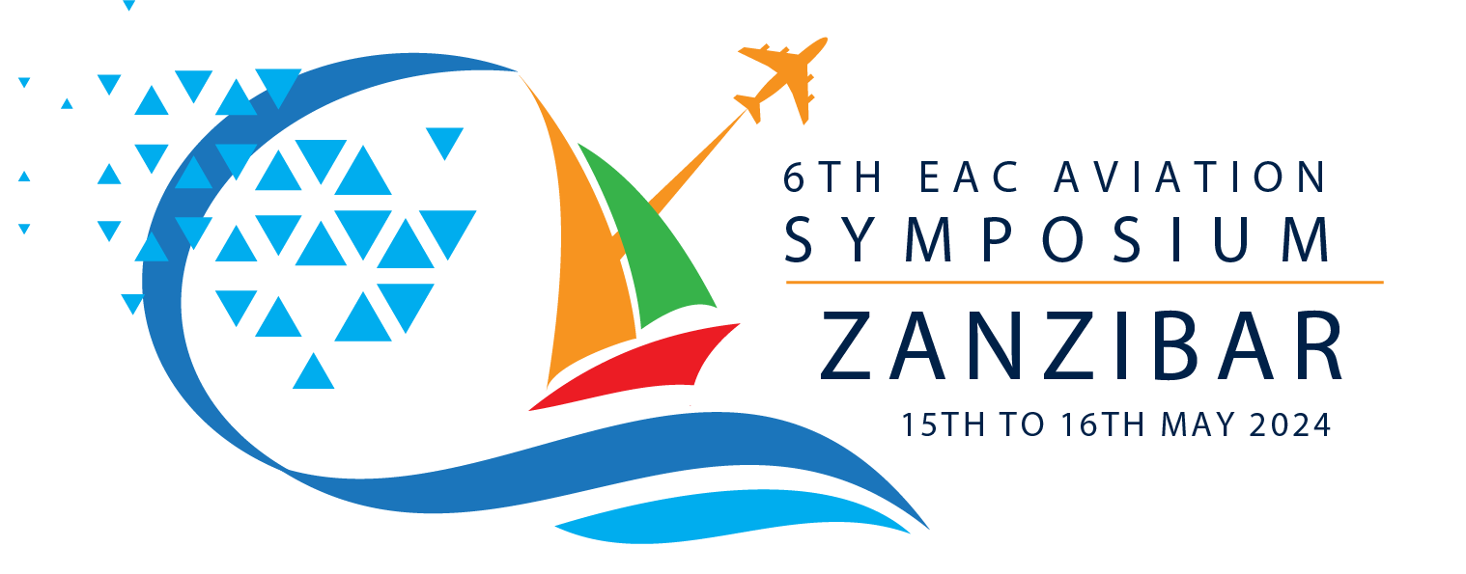
EAST AFRICAN COMMUNITY CIVIL AVIATION SAFETY AND SECURITY OVERSIGHT AGENCY (EAC-CASSOA)
Paul Lukanga
Director Technical
15th May 2024

Slide 2
CONTENTS
EAC - CASSOA Establishment
Objectives and Functions of the Agency
Benefits of being part of CASSOA
RSOO Categories
CASSOA key activities.
Success stories and impact on states
Ongoing Projects
Challenges and Mitigations
The future

Slide 3
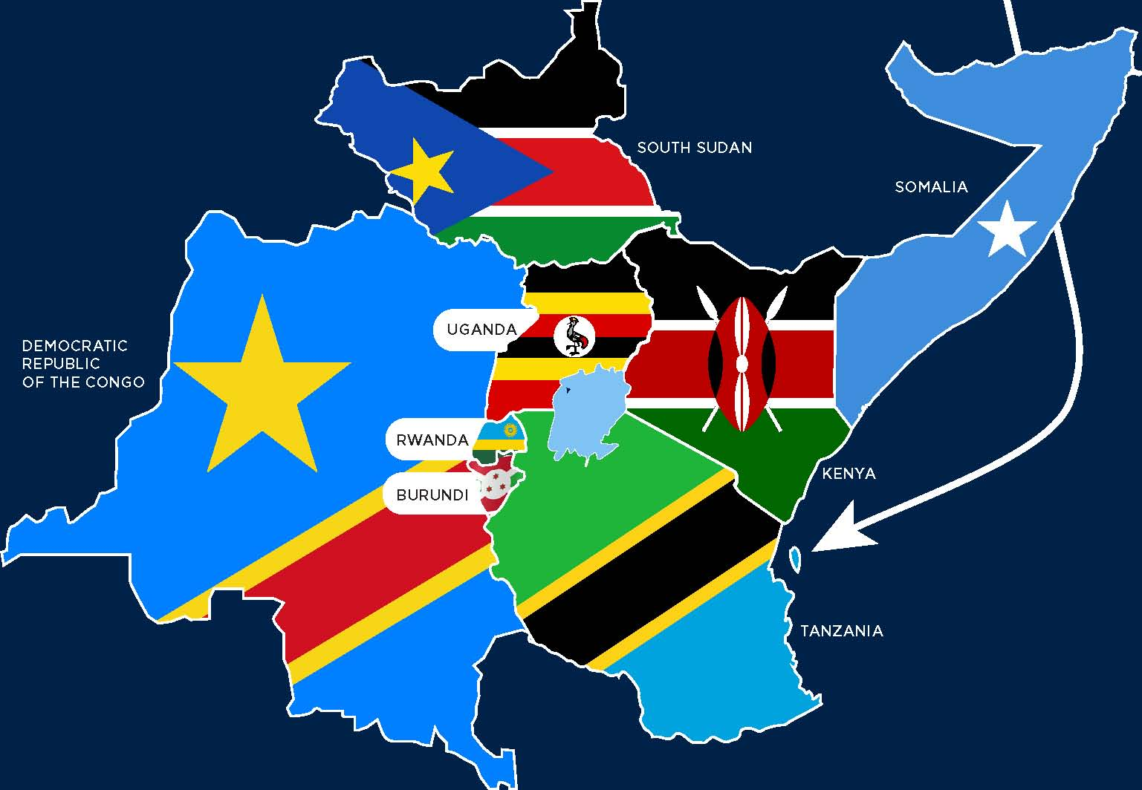
EAST AFRICAN COMMUNITY (EAC)
A regional intergovernmental organization of Partner States:
Established in 1999 by a Treaty among 3 founding states.
Uganda, Kenya & Tanzania (URT).
8 Partners states now;
Rwanda, Burundi, South Sudan, DRC , & Somalia (FRS).
Mission
To widen and deepen economic, political, social and cultural integration in order to improve the quality of life of the people of East Africa.
Institutions:
EADB, LVBC, LVFO, IUC, EAKC, EASTECO, IUCEA, EACA, EAHRC CASSOA

Slide 4
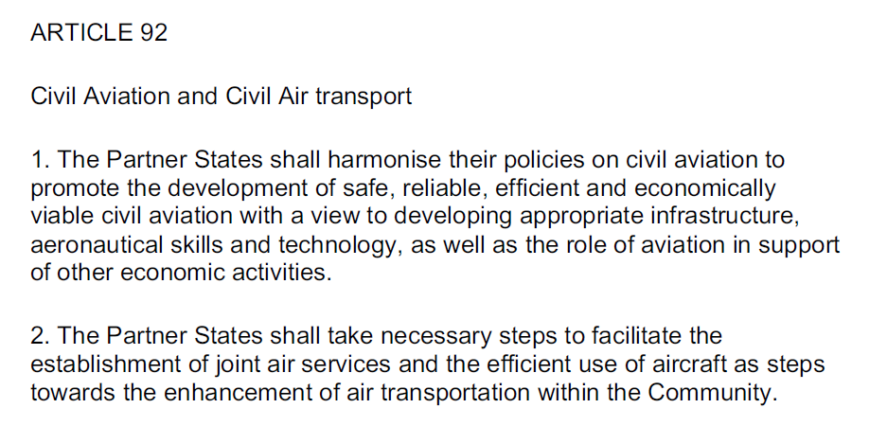
ABOUT EAC - CASSOA
An EAC RSOO Established by EAC Partner States.
Headquarters in Entebbe, Uganda
Derives its Mandate from Article 92 of the EAC -Treaty
Mission – To enhance Safety and Security Oversight Systems in Partner States by Harmonizing Civil Aviation Standards and Best Practices.
Vision - To be a Model RSOO
Includes all 8 EAC Member States.

Slide 5
ORGANIZATIONAL STRUCTURE

Slide 6
OBJECTIVES OF CASSOA
1. Promote Safe, secure and efficient development and use of civil Aviation.
2. Support Partner states in meeting their Safety and Security Obligations
3. Provide a forum and structure for collaboration and implementation of common measures.
Level 1 RSOO - Advisory and coordinating functions.
Harmonizing operating regulations and TGMs
Provide guidance and assistance to Partner States
Facilitating sharing of personnel and resources

Slide 7
RSOO CATEGORIES
Level I RSOO -
Advisory and coordinating functions.
No delegation for regulating, certifying or supervising operators
Level II RSOO -
Operational assistance (Audits and Investigations)
Delegated functions but no issuance of certificates, licences and approvals
Level III RSOO -
Certification Activities (delegated or empowered by legislative framework)
Issuance of certificates, licences and approvals
State maintains responsibility for safety oversight for certification

Slide 8
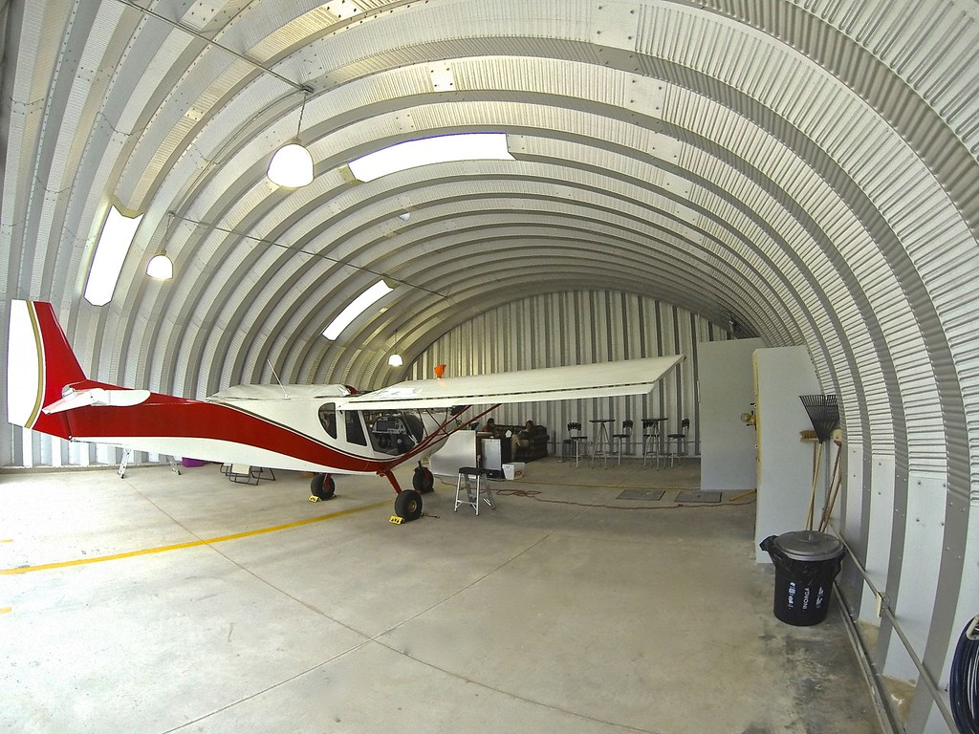
OPERATIONAL ACTIVITIES
Technical missions - All Audit areas
Working groups - Experts from Partner States
Trainings and workshops
Project management and implementation
Certification support for Operators including Airports.
USOAP and USAP support
All Activities financed mainly by the partners states and supplemented by development partners.

Slide 9
KEY PARTNERS
ICAO and Regional Offices – Technical support
EASA – Dev’t Partnerships & Capacity building
FAA – Trainings and Capacity Building
RSOOs – Collaboration
OEMS – Trainings and Technical Support
Operators – AOCs, AMOs, ATOs, Airport, ATNS
IATA, CANSO,
Aeronautical associations: IFALPA, IFATCA, IFATSEA
etc

Slide 10
WHY BE PART OF CASSOA
Ready to use Harmonized regulations, procedures & TGMs
Sharing of resources (Finance, IT and infrastructure)
Sharing of Technical Personnel & Expertise.
Increased bargaining power.
Collaboration on certification and training activities

Slide 11
SUCCESSES
Common EAC examination system.
Harmonized civil aviation legislation & TGMs
Center for Aviation Medicine
Deployment of common IT systems
SOFIA, ECCAIRS 1, PEXO 2
USOAP and USAP support.

Slide 12
CASSOA IMPACT ON PS: SAFETY

Slide 13
CASSOA IMPACT ON PS: SECURITY

Slide 14
ONGOING PROJECTS
Automatic validation (ongoing)
Common civil aviation legislation & TGMs
Deployment of common updated IT systems SOFIA, ECCAIRS 2, PEXO3
AIG Unit set up
GASOS/RRAP Certification – October 2024
Support for setting up a Safety Oversight System in South Sudan and Somalia

Slide 15
MAIN CHALLENGES
Financial Constraints
Sustainable funding Mechanism
Development partnerships
Lean Structure with High Staff Turn over
New Retention and Attraction Strategy.
State Secondment Options.
Slow responsiveness from states
More awareness and involvement for all stake holders
Complex and specialised training requirements
Collaborations (MOUs) with partners and regional bodies.

Slide 16
THE FUTURE
Common Regulatory frame work.
Open Skies and boarders.
Improved Safety and Security systems.
New Technologies
More CASSOA visibility and impact.

Slide 17
WHAT TO LOOK FORWARD TO
Common Regulation
Open Skies and boarders
Improved Safety and Security
New Technologies
More CASSOA visibility and impact
ASANTE SANA

