Slide 1
Requirements to Initiate Foreign Air Service Operations to the United States
Presented by Nancy Vachon, GS&RA MEA
For the EAC-CASSOA 6th Symposium on May 15th, 2024 in Zanzibar

Slide 2
Agenda
Introductions
FAA Part 129 Foreign Air Carriers Requirements
FAA IASA Process Overview
Q&A
Boeing is acting in an advisory capacity and will not be directly involved in the process of re-writing regulations, handbooks, guidance/advisory material, inspector training, etc.

Slide 3
Our Mission
We help strengthen the safety of the global aviation ecosystem by engaging with aviation regulators to improve their ability to provide rigorous safety oversight of the aviation activities in their respective States.
This mission aligns with GASP goal #2 as stated in ICAO Doc 10004:
“Goal 2 calls for all States to strengthen their safety oversight capabilities.”

Slide 4
Our Team
Director
Global Safety & Regulatory Affairs
Staff Analyst
Executive Office
Administrator
Theresa Capili
Todd Sigler
Tracy Manspeaker
Autonomous Systems
Global Regulatory Strategy,
ICAO Liaison
Global Safety Strategy
International Teams
Stella Weidner
Mildred Troegeler
David Zwegers
Victoria Wilk
Regulatory Strategy
OPEN
Regulatory Affairs
Autonomous Systems
Regulatory Strategy-Emerging Technologies
System Safety
Safety & Regulatory Affairs
WDC
Safety & Regulatory Affairs
Europe
Perry Rea
Ben Ivers
Zach Beckmann
Kalan Guiley
Kara Charles
Eric DeMoney
WISK Safety & Airworthiness
Principal Global Regulatory Strategy
Yohannes Amare
José Muñoz
Paul Arends
Gunter Ertel (ATF)
Ross Godwin
Sid Prem
Melaku Tadesse
Safety & Regulatory Affairs SE Asia / India
Safety & Regulatory Affairs North Asia
Kimberly Matthews
Reece Clothier
Myles Brown
Thomas Martig
Safety & Regulatory Affairs
ME / Africa
Safety & Regulatory Affairs Latin America
Technical Fellows
Kayode Ariwodola
Mike Snover
Technical Fellow
Associate Technical Fellow
Monica Alcabin
Chris Eisele
Associate Technical Fellow
Associate Technical Fellow
Gunter Ertel
Paul Stanley

Slide 5
Regulatory Capability Support
Support CAA Safety Oversight capability
Assist CAAs in improving their safety oversight capability
Prepare CAAs for Safety audits and assessments (e.g., FAA IASA, ICAO USOAP, EU SAFA/SACA, etc.)
Conduct a limited-in-scope gap assessment on how well a CAA meets ICAO Standards and offer guidance on areas needing improvement
Assist CAAs in the development and implementation of corrective action plans
Notes:
Assist CAAs in improving safety oversight capabilities; prepare CAAs for safety audits; Assist CAAs in developing/implementing corrective action plans to findings of non-compliances to ICAO standards. Also, we support CAAs in their application for operation into the U.S.

Slide 6
Module 1
Requirements to Initiate Foreign Air Service Operations to the United States

Slide 7
Requirements to Initiate Foreign Air Service Operations to the US*
Air Carrier
Submits Economic Authority Application
Submits 14 CFR Part 129 application to FAA
(Typically, after CAA obtains Cat 1)
Submit Model Security Program (MSP) to TSA
Submit list of Last Point of Departure Airports
U.S. Air Service can commence
CAA
CAA Addresses IASA Findings
FAA
(US Federal Aviation Administration)
FAA Conducts IASA and Submits Findings to CAA
FAA grants Cat. 1 Safety Rating
FAA issues Part 129 Ops Specs
DOT
(US Dept. of Transportation)
DOT requests FAA to conduct IASA
DOT issues Economic Authority
DHS/TSA
(US Dept. of Homeland Security)
Reviews & accepts Security Program
(49 CFR 1546)
Assess Last Point of Departure Airports
*This is not an exhaustive list off all necessary activities
Notes:
Boxes in green are “gates”

Slide 8
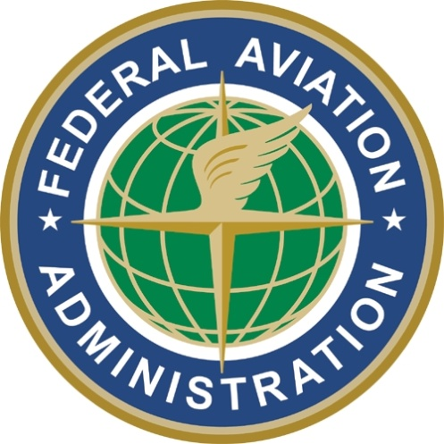
U.S. Operations Approval Requirements
State / Regulator
(18-24 month typical lead time)
Air Operator
(12 month typical lead time)
Department of Transportation (DOT)
Air Services Agreement
Federal Aviation Administration (FAA)
IASA Category 1 Rating
Transportation Security Administration (TSA)
Last Point of Departure (LPD) Security Inspection
Department of Transportation (DOT)
U. S. Agent for Service
Economic Authority or Exemption
Federal Aviation Administration (FAA)
14 CFR Part 129 Approval
Transportation Security Administration (TSA)
Model Security Program (MSP)
Timing can vary significantly based on circumstances and commitment

Slide 9
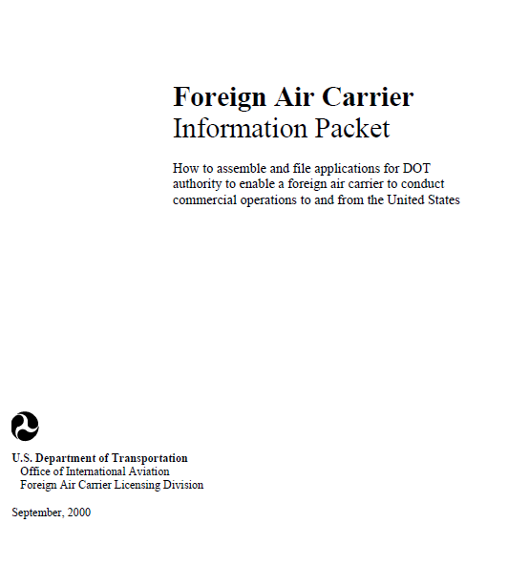
DOT Economic Authority
Economic Authority must be obtained from the DOT before a foreign operator may conduct any passenger or cargo operations to and from the United States (49 U.S.C. 41301)
This is typically the first step in the process
14 CFR Part 211, ‘Applications for Permits to Foreign Air Carriers’ defines filing and evidence requirements
Country to Country Air Services Agreement must be in place
A foreign air carrier application information packet is available on the DOT web site
https://www.transportation.gov/policy/aviation-policy/licensing/foreign-carriers
Questions may be directed to the DOT’s Office of International Aviation at (202) 366-2405

Slide 10
FAA Authorization Requirements
International Aviation Safety Assessment (IASA)
14 CFR Part 129 Operations Specification
Administered by Flight Standards International Programs and Policy Division (AFS-50)
Assessment is based on compliance to ICAO Annexes 1, 6, and 8
FAA Technical Assistance and Technical Review (mock IASA) is available at a cost, and an MOU will be required between MCAA and the FAA
Administered by the responsible International Flight Standards Office (IFO) – e.g. Los Angeles
Applies to ‘N’ registered operated by a foreign operator (e.g. 129.14) and foreign registered aircraft flying to the U.S.
FAA Order 8900.1, Volume 12, Chapter 4 provides additional information
http://www.faa.gov/about/initiatives/iasa/
https://drs.faa.gov/browse/ORDER_8900.1/doctypeDetails

Slide 11
IASA vs. Technical Review (TR)
IASA
Technical Review (TR)
Formal Audit (State to State)
IASA Checklists used for Assessment
Typically, 5 days on site
The FAA Team: Team Leader, Ops, Airworthiness and Attorney
Verbal out-brief and written findings reports provided
No technical guidance provided by FAA
No charge to Foreign CAA
Safety Category Determination Mandatory
Informal Audit (FAA to CAA)
IASA Checklists used for Assessment
Typically, 5 days on site
The FAA Team: Team Leader, Operations, Airworthiness and Attorney
Verbal out-brief and written findings reports provided
Technical guidance may be provided by FAA
Charge to Foreign CAA
No Safety Category Determination

Slide 12
FAA International Aviation Safety Assessment (IASA)FAA’s Foreign CAA Aviation Safety Oversight Audit Program
An audit of a foreign CAA required for that country’s airlines to conduct commercial operations to the US
A category rating is assigned to each country based on compliance with ICAO Annexes 1, 6, and 8:
Category 1 CAA meets ICAO standards
Category 2 CAA does not meet ICAO standards
Unrated Assessment of CAA has not been conducted
A Category 2 designation or downgrade will preclude any new U.S. operations and restrict codeshares with U.S. airlines
Existing Part 129 approvals are ‘frozen’ at current levels

Slide 13
TSA Authorization Requirements
Foreign Airport Assessment Program (FAAP)
49 CFR 1546 – Foreign Air Carrier Security
New ‘Last Point of Departure’ (LPD) airports will require evaluation for U.S. direct flights
Assessment is based on compliance to ICAO Annex 17 and 49 CFR Subtitle B Chapter XII
Advance coordination required (scheduling, access permission, potential findings)
Foreign air carriers must adopt and carry out a security program that meets the applicable requirements
The TSA Model Security Program (MSP) meets the requirements of Subpart B
TSA will audit a foreign air carriers security practices for compliance
Contact the responsible TSA International Industry Representative (IIR) to initiate the process

Slide 14
14 CFR Part 129 Approval
Operator should initiate contact with the responsible FAA International Field Office (IFO)
Contact Dallas / Ft. Worth IFO
Phone: (214) 277-0300
Office Hours: 8:00 a.m. to 4:00 p.m. Central Time, Monday–Friday
Email

Slide 15
Requirements to Initiate Foreign Air Service Operations to the US*
Air Carrier
Submits Economic Authority Application
Submits 14 CFR Part 129 application to FAA
(Typically, after CAA obtains Cat 1)
Submit Model Security Program (MSP) to TSA
Submit list of Last Point of Departure Airports
U.S. Air Service can commence
CAA
CAA Addresses IASA Findings
FAA
(US Federal Aviation Administration)
FAA Conducts IASA and Submits Findings to CAA
FAA grants Cat. 1 Safety Rating
FAA issues Part 129 Ops Specs
DOT
(US Dept. of Transportation)
DOT requests FAA to conduct IASA
DOT issues Economic Authority
DHS/TSA
(US Dept. of Homeland Security)
Reviews & accepts Security Program
(49 CFR 1546)
Assess Last Point of Departure Airports
*This is not an exhaustive list off all necessary activities

Slide 16
Other Requirements for U.S. Service
Agency | Tasks | Timeframe
U.S. Department of Transportation (DOT) | Submit application for exemption or permit to operate scheduled or charter flights to and from the U.S. Submit insurance certificate, designation of agent, Warsaw waiver, family assistance plan, and passenger manifest data collection statement. | Minimum 2-3 months prior to commencement Prior to commencement (can be submitted with DOT application or separately).
U.S. Federal Aviation Administration (FAA) | Submit application for operations specifications per Part 129 of Federal Aviation Regulations. | Minimum 4-6 months prior to commencement
U.S. Transportation Security Administration (TSA) | Submit proposed security plan to TSA. | Minimum 90 days prior to commencement
U.S. Internal Revenue Service (IRS) | Submit application for Employer Identification Number (EIN) | Minimum 45 days prior to commencement (EIN will be required for Customs bond and may be required for airport operating permit).
U.S. Customs and Border Protection (CBP) | Request landing rights at each U.S. point to be served. Establish Customs bond Demonstrate ability to comply with APIS passenger manifest transmission system Execute Visa Waiver Program Agreements | Minimum 30 days prior to commencement Minimum 60 days prior to commencement Minimum 2 weeks prior to commencement Minimum 2 months prior to commencement
U.S. Department of Agriculture (APHIS) | Notify APHIS of schedule | Minimum 30 days prior to commencement
U.S. National Transportation Safety Board (NTSB) | Submit family assistance plan | Prior to commencement
U.S. States | Submit application to qualify or register to transact business in each U.S. state the carrier will serve. | Prior to the beginning of ticket sales. Proof of qualification or registration may be required by airport operation permit application.
U.S. Airports | Submit application for airport operating permit. Carrier may be required to post a bond equal to several months of anticipated landing fees. | Varies by airport

Slide 17
References
Department of Transportation (DOT) Foreign Air Carrier Application Information Packet
FAA Los Angeles International Field Office (IFO) Information Handout
14 CFR Part 129 Pre-application Job Aid
FAA Order 8900.1 Volume 12, Chapter 4
Office of the Secretary of Transportation (OST) Form 6411 – Proof of Insurance
https://www.faa.gov/sites/faa.gov/files/about/office_org/headquarters_offices/avs/WebOPSS_DCS_eAIM_OAPS_Overview.pdf
WebOPSS New User Request Form

Slide 18
Module 2
International Aviation Safety Assessment
(IASA) Process Overview

Slide 19
IASA Process Overview
Consultation Process
Preparation Process
U.S. provides formal notice to country of FAA request for an assessment
IASA Assessment
FAA Team conducts in-country assessment
CAP
FAA issues formal written report
Country prepares for IASA assessment; completes IASA checklist and submits to the FAA
FAA Team provides out-brief and summary of assessment findings
Country begins CAP process in anticipation of report
Country continues implementing CAP
FAA conducts verification visit during final consultations
CAT 1 or CAT 2 status determined following CAP implementation
Notes:
The Regulatory Capability Team can support all of these activities.

Slide 20
IASA Process Overview – Notification
Official notification of an IASA audit is coordinated through the U.S. Department of Transportation and the U.S. State Department
When approved, official notification or cable will be delivered by the U.S. Embassy to the most senior official at the CAA
The cable must be delivered at least 30 days prior to team arrival
With the cable is a copy of the FAA IASA Checklists (hyperlinks may be provided) for the CAA to conduct a self-assessment and return it to the IASA Team Leader prior to the team arrival
The CAA will be requested to provide responses to the checklist questions prior to the in-country assessment

Slide 21
IASA Process Overview – In-country Assessment & Out-briefing
The IASA assessment is typically conducted over the course of one week by a team consisting of a Team Leader and experts in operations, airworthiness and aviation law
It is possible to have another member who is undergoing training
The Team will sample documentation, processes and records
The Team typically will visit one or more certificate holders during the visit (at least one of the major carriers) to evaluate the relationship between the CAA and the certificate holder
The Team will not assess the certificate holder itself
A verbal out-brief will be provided on the final day, which will provide an initial overview of the findings uncovered and in which areas
There will be no contact with the media

Slide 22
IASA Process Overview – IASA Report
The official written report will arrive a few weeks after the team leaves
The report will provide:
An executive summary and list of participants from the IASA Team and the CAA, and the areas assessed;
A list of the FAA team’s findings and observations broken down by specific CEs, and;
The team’s conclusion as to whether the CAA meets the respective ICAO SARPs related to a CE
If the CAA meets the ICAO ISARPs for all the CEs in Annexes 1, 6, and 8, the FAA Team will recommend that the country be rated CAT 1
If the Team determines that the CAA is deficient in any of the CEs, the FAA will proceed to a 65-90 day period of diplomatic consultations, which will include in-country final consultations

Slide 23
IASA Process Overview – Diplomatic & Final Consultations
The FAA will coordinate with the CAA to agree on an appropriate date for final consultations
Final consultations are typically scheduled for 65-90 days after the IASA assessment
The CAA has the opportunity during the 65-90 day period to implement a CAP to address any shortcomings identified
The FAA consultation team will arrive at the specified date and will review all the corrective actions in the CAP for effective implementation

Slide 24
IASA Process Overview – IASA Categorization
Following the consultations, the FAA will make an official determination of the CAA’s compliance with ICAO SARPs
The FAA will then disclose the results of the IASA assessment so that the traveling public can make informed travel decisions
The results and decision will be disclosed through an FAA press release and a formal notification back through the US Embassy
The FAA will periodically re-assess countries to ensure they continue to be compliant with ICAO SARPs

