Slide 1
Republic of Rwanda
Ministry of Infrastructure
Current Status and Mechanism for Strengthening Accident and Incident Investigation in the Region.
Tuesday, 14 May 2024

Slide 2
Outline
Why investigation of aviation Occurrence?
Regional accident statistics
Accidents by occurrence category
EAC Partner State compliance with ICAO Annex 13 SARPs
The way forward - effective SSP

Slide 3
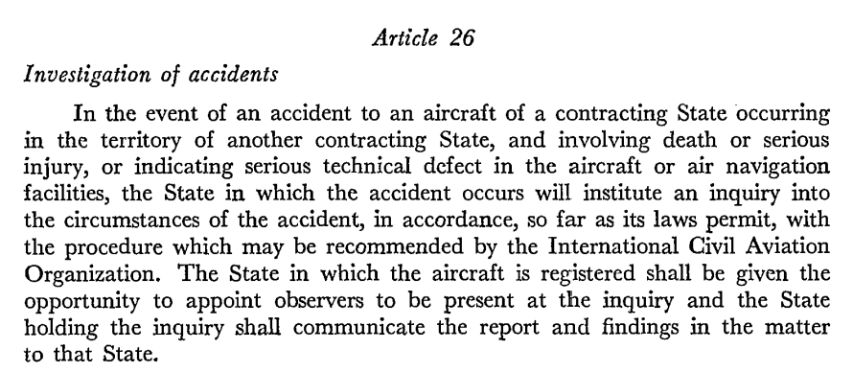
Background
Article 26 of the Chicago Convention:
Provides for the investigation of aviation accidents;
Mandates State of occurrence to Institute the investigation;
Provides for other States to appoint observers.
Notes:
Aircraft accident investigations generally, but not always, are conducted by the State in the which the accident occurs (the State of occurrence), regardless of whether the accident aircraft is registered in that State or was operated by an airline registered in that State.
This requirement is stipulated in Article 26 of the Convention on International Civil Aviation (CC), which says that “in the event of an accident to an aircraft of a Contracting State occurring in another Contracting State, and involving either death, serious injury, or serious technical defect in the aircraft or air navigation facilities, the State in which the accident occurs will institute an inquiry into the circumstances of the accident.”
The State of occurrence may delegate all or part of the investigation to another State or a regional accident and incident investigation organization and may also call on technical expertise from any source to assist with the investigation.
The States that generally are entitled to participate in an investigation include the State of the aircraft operator, the State where the accident aircraft is registered, the State of aircraft design and aircraft manufacture, and a State that has a special interest in the accident, such as because of fatalities or serious injuries to its citizens.

Slide 4
Sole objective of investigating aviation occurrences
The prevention of accidents and incidents.
The purpose is not to apportion blame or liability.
Notes:
Objective
The sole objective of the investigation of an accident or incident shall be the prevention of accidents and incidents. It is not the purpose of this activity to apportion blame or liability. (ICAO Annex 13, Aircraft Accident and Incident Investigation)

Slide 5
Accident/Fatality Rates by Year in EAC based on i-STARS Data
The accident trend analysis shows a regression on the rate of accidents for the period of 2013–2022.
Period 2013 until 2016 shows a significant reduction of accidents.
Period 2016 until 2022 shows a trend of increment.
Year 2021 shows significant low rate likely due to impact of COVID-19, resulting in a reduction of the flights.
Fatality rate relatively constant suggesting further investigation such as improving rescue operations.

Slide 6
Current Rwanda Performance vs RASG-AFI
EAC accident rates are high as shown in Partner State.
Its is critical that the reports are shared and acted upon within the region.
Partner States urged to committee resources in the investigation of aviation occurrences to reduce rate of accidents.

Slide 7
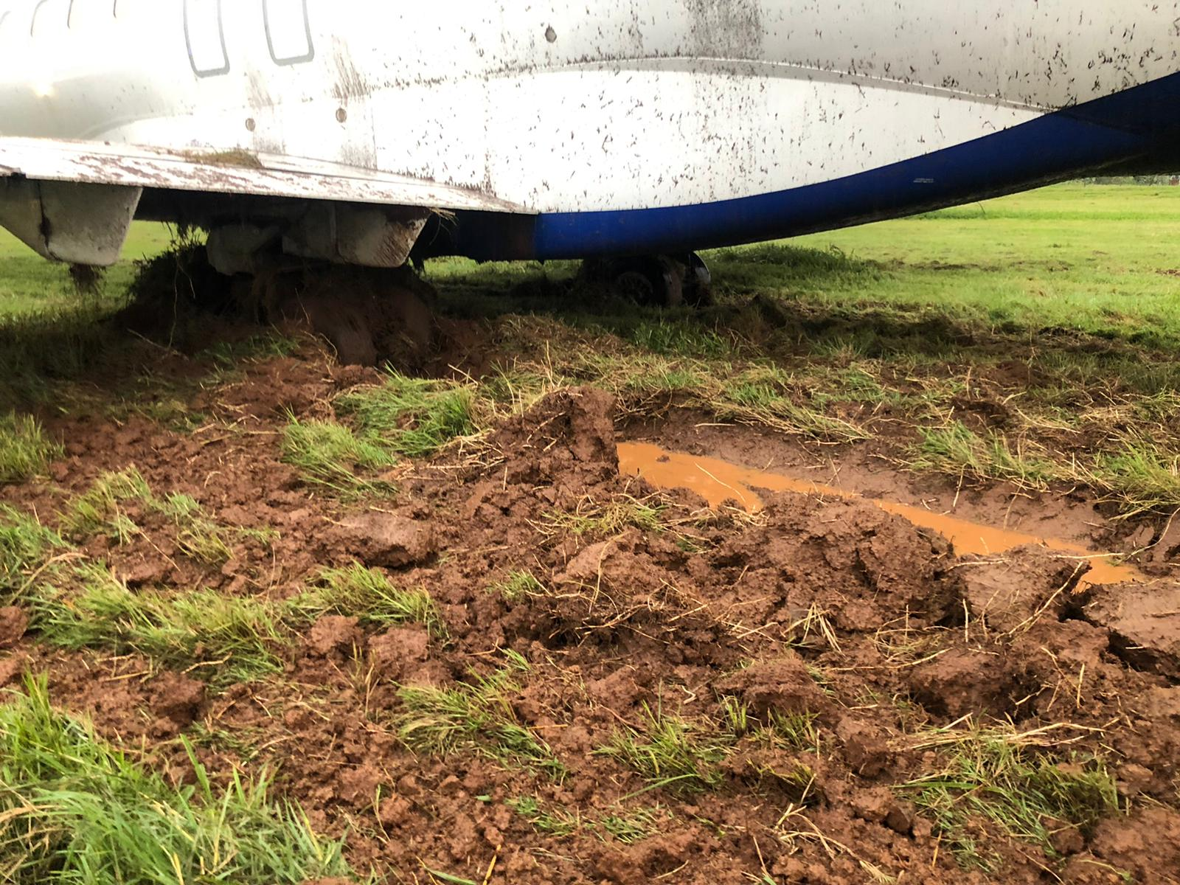
Occurrence by Category- Based on i-STARS Data
Runway Excursions are leading in EAC region.
Aircraft damage due to Wild life on the increase causing disruptions in flight operations.
Notes:
This is due to the fact that the Directorate is operating under Public Service conditions and therefore unable to recruit and retain the highly skilled manpower to conduct aviation accidents/incidents investigations as required.

Slide 8
Ground Handling Related Occurrences on the rise
With the growth of air traffic and the proliferation of third party ground handling companies, ground operations on airport aprons have become increasingly complex and potentially hazardous.
Time industry considers conducting oversight of ground handling companies and flight safety services for a well interfaced safety management system.
Wrong Cargo Hold
Notes:
Ground handling forms a significant and critical part of the aviation industry.
For several years the air operator, aerodrome and ground handling sectors of industry, together with a number of State regulators, have been concerned with the:
level and extent of damage to aircraft during ground handling and
rate of safety occurrences to aircraft, passengers and airport workers.
Aerodrome safety is a vital link in aviation safety. Aerodrome safety is achieved by providing aerodrome facilities and maintaining aerodrome environments that are safe for aircraft operations.
By complying with the prescribed standards and procedures and taking a pro-active safety management approach in the operation of their aerodromes, aerodrome operators can demonstrate that they have discharged their safety obligations to the travelling public.
With the growth of air traffic and the proliferation of third party ground handling companies, ground operations on airport aprons have become increasingly complex and potentially hazardous
Increasing apron operations and larger aircraft demand an increase in ground support equipment and faster turnarounds.
Considering all these challenges, effective oversight of ground handling activities is urged.

Slide 9
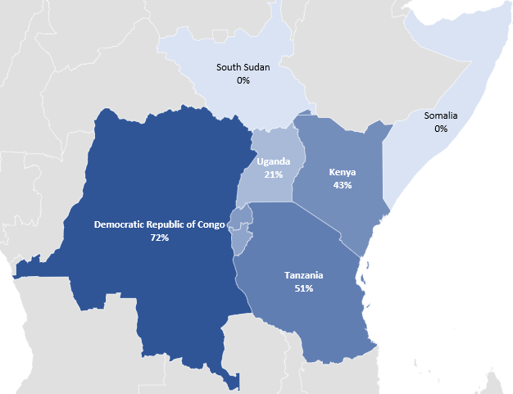
EAC Effective Implementation of ICAO Annex 13 SARPs
Key challenges as identified by ICAO include:
Lack of Qualified personnel to:
establish credible investigation entities as well as to conduct the investigations.
Develop appropriate legislation, regulations, and technical guidance material.
Lack of training institutions for aircraft accident investigation in EAC and in Africa in general.
Rwanda
37%
Burundi
32%
Notes:
EAC Average EI of ICAO SARPs is 30.34%,
AFI-Region Average EI of ICAO SARPs is 42%
World Average EI of ICAO SARPs is 60%.
Notes:
Aircraft accident investigations are handled differently by States. At present, some States in the region have not established an independent body responsible for the investigation of aircraft accidents and incidents. In some States, established departments take charge. In others, a committee is assembled specifically for each occurrence. However, these do not address the situation of independence of the entity of AIG because:
In many circumstances, these departments or committees have neither adequate financial resource nor fully trained personnel necessary to perform investigation duties. Moreover, as these departments or committees fall within the organizational structures of their respective civil aviation authorities, the independence of the investigation as established by ICAO is not guaranteed. Hence, the need to subscribe to a regional body for the economy of scales where resources can be harnessed in achieving the predetermined business goals and objectives.
According to ICAO report of 2022, from a total of 31 accidents, 7 were fatal resulting in 241 fatalities. This resulted in 19 accidents per million departures.
There is then a correlation between the low EI (42.86%) of AIG related SARPs and the high accident rate of 5.63 accidents per million departures in the region just in 2022.

Slide 10
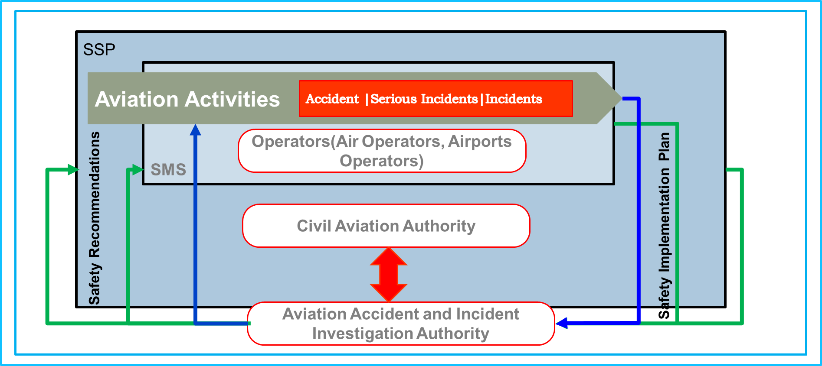
SSP and AIG: Implementation Model in Rwanda
Complementarity between aviation stakeholders and AIG
Establish framework for information/data sharing in the EAC region,
Sharing resources in the conduct of accident investigation including simulation of incidents in the region.

Slide 11
Quick Takeaways: Way Forward for EAC
Reduce both accident and fatality rates to below AFI-Region average of 26.66 per million departures and fatalities.
Create a platform for structured sharing of knowledge, experiences and providing technical assistance to Partner States requiring help.
Share resources for the conduct of accident investigation including simulation of incidents in the region.
Considering the 16th EAC Sectoral Council on Transport, Communication and Meteorology meeting held in June 2019, accelerate the establishment of the framework for EAC regional accident investigation for the benefit of all Partner States.
Improve AIG EI of Annex 13 to sustain the current and projected aviation industry growth and make significant contribution towards Global Aviation Safety Plan (GASP) Goal One of achieving a continuous reduction of operational safety risks through investigation of civil aircraft incidents and accidents.

