Slide 1
6TH EAC AVIATION SYMPOSIUM 15th – 16th May 2024 Examining legal considerations related to air traffic control, airspace management, and air navigation services visa vie growing traffic density Shukuru Andrew Nziku Chief ATM - TCAA

Slide 2
SCOPE
Introduction
ATM regional initiatives and enablers to manage growing traffic density
Way-forward

Slide 3
INTRODUCTION
Facts
Aviation industry is highly controlled and regulated due to its inherent risks involved.
“Global air traffic has doubled in size once every 15 years since 1977 and will continue to do so” (Doc 9750 - GANP).
ICAO Vision on ATM Operational Concept (Refer Doc 9854 – GATMOC)
ICAO defined 7 interdependent concept components that will be integrated to form the Future ATM system.

Slide 4
INTRODUCTION
Airspace Organization and Management (AOM)
Aerodrome Operations (AO)
Demand and Capacity Balancing (DCB)
Traffic Synchronization (TS)
Conflict Management (CM)
Airspace User Operations (AUO)
ATM Service Delivery Management (ATM SDM)

Slide 5
GLOBAL ATM INITIATIVES
ASBU FRAMEWORK
Global initiative to reach SEAMLESS OPERATIONS in ANS and Airport operations.
Strategic Plan:
Requirements:
GANP
ASBU Framework
Interoperability of ATM systems
Harmonization of procedures
Block 0 – up to 2013
Block 1 – up to 2019
Block 2 – up to 2025
Block 3 – up to 2031
Block 4 – up to 2037

Slide 6
GLOBAL ATM INITIATIVES….
1. Free Routing Airspace (FRA) – B1/1
FRA concept represents a significant step forward in ATM, offering benefits in terms of efficiency, flexibility, and environmental sustainability for both airlines and airspace authorities.
FRA is more effective when applied in large airspace.
Regulatory Considerations: FRA implementation require updates to regulations, airspace designations, and operational procedures to ensure compliance with safety standards and requirements.

Slide 7
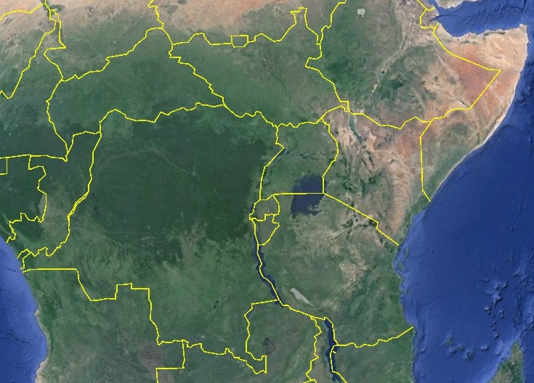
HCMM – FZAA:
1837 nm
HSSM – FZQA:
1288 nm
HAAB – FAOR:
850 nm in EAC

Slide 8
GLOBAL ATM INITIATIVES….
Air Traffic Flow Management (ATFM)
Annex 11 (ATS) paragraph 3.7.5.1 states that…ATFM shall be implemented for airspace where air traffic demand at times exceeds, or is expected to exceed, the declared capacity of the ATC services concerned…
The modern concept of ATFM has evolved to facilitate the safe, orderly and expeditious flow of air traffic by ensuring that ATC capacity is optimized and utilized to the maximum extent possible, and allowing the traffic demand to be compatible with ATC capacity. (Doc 9971 paragraph 1.2.3)

Slide 9
GLOBAL ATM INITIATIVES….
Reginal ATFM is more effective as compared to National ATFM in realizing safety, efficiency, environment impact mitigation and cost saving for airlines.
Implementation of regional ATFM require harmonization of regulations and operational procedures as well as reviewing letters of agreements.

Slide 10
GLOBAL ATM INITIATIVES….
Standardized Training of Personnel
Standardized/Harmonized training of personnel is essential for ensuring uniform standards of safety and competence across EAC region.
It involves aligning the curriculum, practical training, assessment criteria and certification/licensing to ensure consistency in skills and knowledge.

Slide 11
ENABLES
Effective Utilization of Surveillance Systems in the region.
Implementation of AIDC between adjacent FIRs to automate ATC coordination and reduce workload to air traffic controllers.
Guidance material is required for EAC/Africa region
Sharing of surveillance data between adjacent FIRs will increase coverage and reliability.

Slide 12
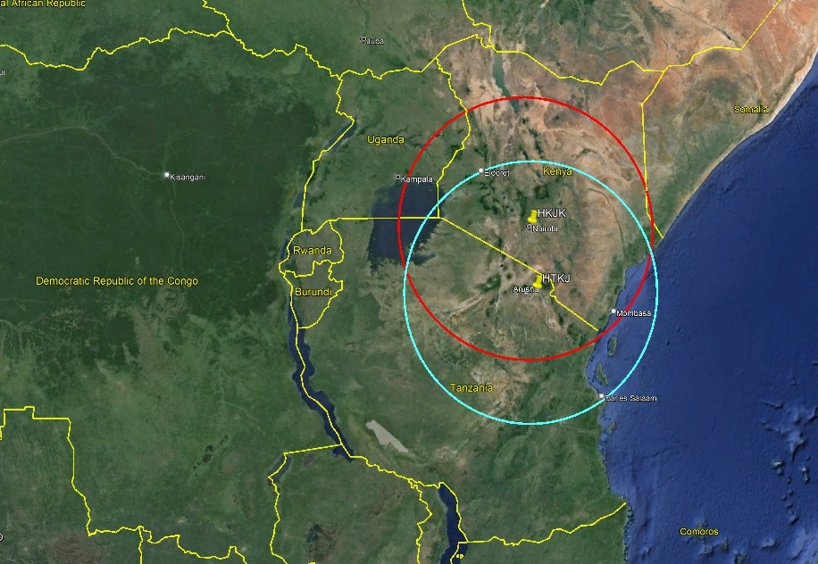
ENABLES….

Slide 13
ENABLES….
Artificial Intelligence (AI)
AI are systems that can perform tasks that would otherwise require human intelligence.
AI-based system will help ATM in the following aspects:
Conflict resolution advisory
Demand prediction
Remote towers
Unmanned Traffic Management (UTM)
Weather impact prediction, etc.

Slide 14
3. WAY FORWARD
Harmonizing regulatory requirements across EAC member states is essential to ensure seamless operations and avoid inconsistencies that could compromise safety and efficiency.

Slide 15
References
Doc 10118
Doc 9750
Doc 9971

