Slide 1







Session xx:
SBAS implementation in Africa:
Exploring Legal, Certification and Governance Frameworks
6th EAC AVIATION SYMPOSIUM
Zanzibar, United Republic of Tanzania :
15th – 16th May 2024

Slide 2
01
To present SBAS.
OBJECTIVES
To explore the legal, Governance and certification frameworks for the implementation of SBAS in Africa.
02
To present the components of certification and discuss the roles to be undertaken by RSOOs.
03

Slide 3
CONTENTS
01
05
Framework for Certification/Safety Verification
About SatNav Africa JPO
02
06
Challenges
About SBAS
03
Context for SBAS implementation in Africa
07
Conclusion
Requirements for SBAS implementation
04
08
Way forward

Slide 4
















ABOUT JPO
Since 2013, an outcome of the Africa-EU cooperation on satellite navigation
Governance
Beneficiaries under working arrangements
Steering Committee Co-Chairs: AUC, EC
Main beneficiaries
  African Union & technical organisations (AFCAC, African Space family)
  Regional Economic Communities
  Air Transport users communities (ICAO, CAAs, ANSPs, airports, airlines)
  Other sectoral organisations (maritime, agriculture, survey & mapping, etc.)
  Capacity building & innovation frameworks (Training Institutions such as AATO, Thies University, JKUAT, etc.)
  Space Agencies
Mission Statement
To support the development of satellite navigation in key sectors in Africa, with aviation as the main driver.

Slide 5
ABOUT JPO : OBJECTIVES AND BUSNINESS LINES
General Objective
Contribute to the development of satellite navigation in Africa in key sectors, with aviation as the main lever
Specific Objective
Consolidate the development of SBAS, as well as the adoption and use of GNSS services in Africa.
Systems & services
Technical support and capacity building to accelerate the development of regional SBAS modules and the integration of SBAS into continental policies and planning
Markets & adoption
Support for the adoption and use of GNSS services and the development of associated applications and markets in Africa

Slide 6
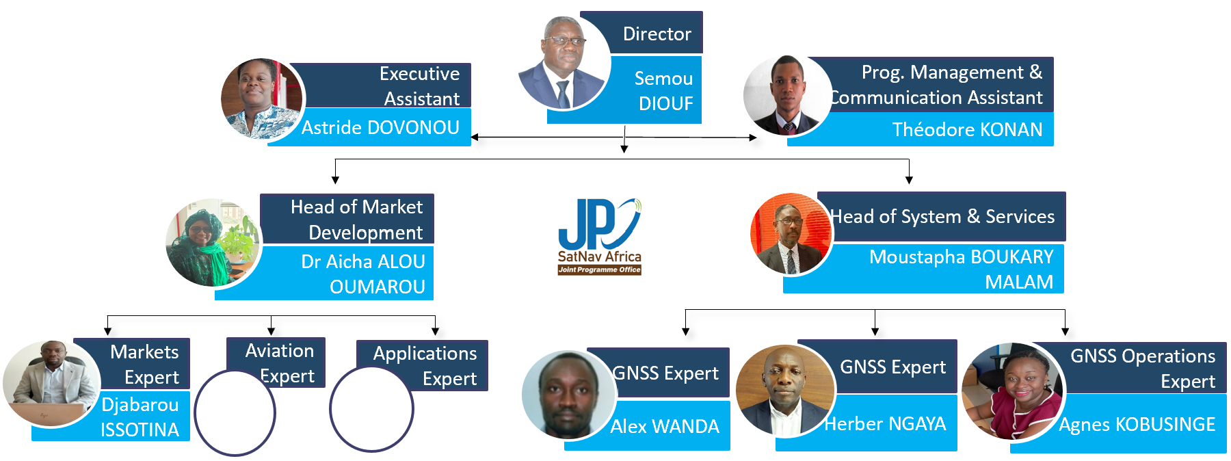
ABOUT JPO : SatNav Africa JPO TEAM

Slide 7
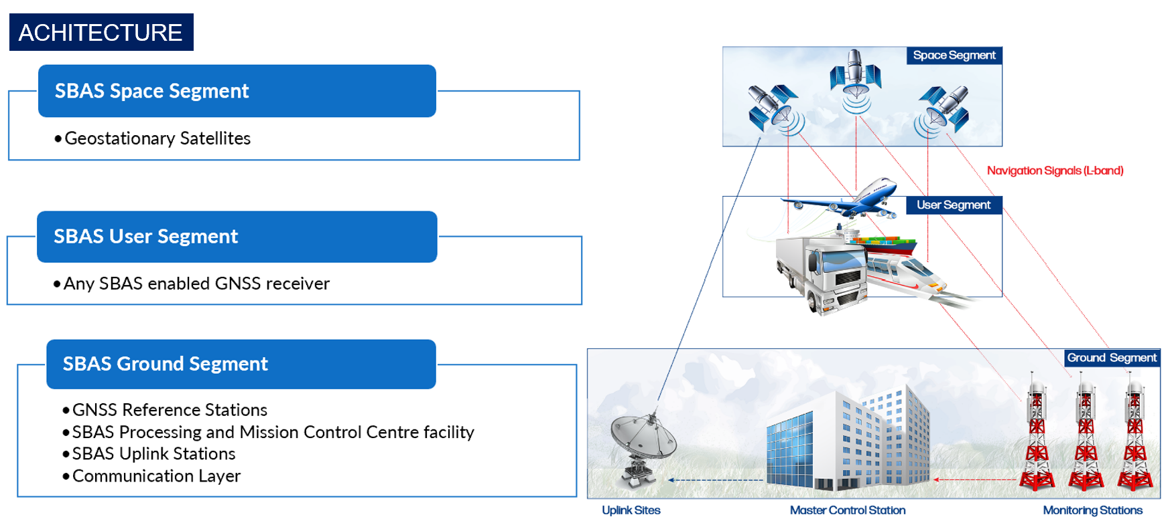
ABOUT SBAS

Slide 8
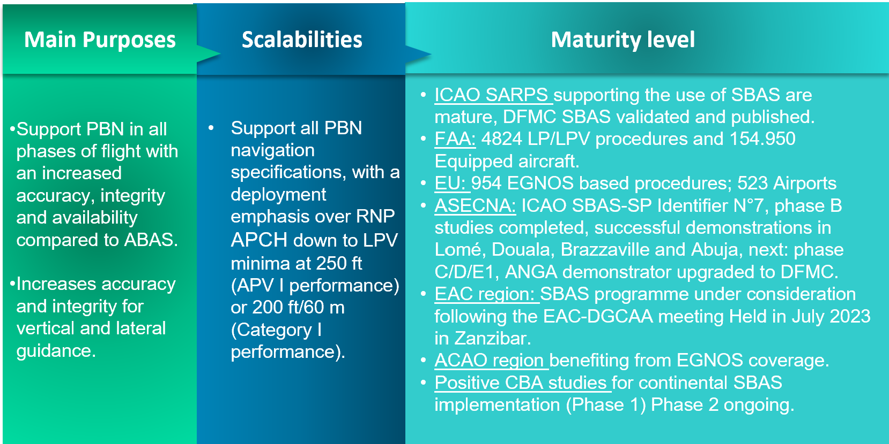
ABOUT SBAS: Brief

Slide 9
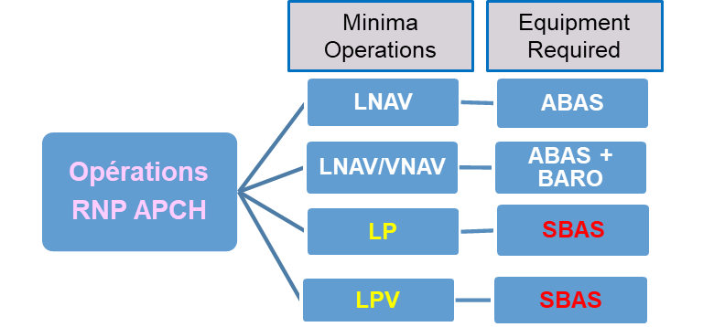
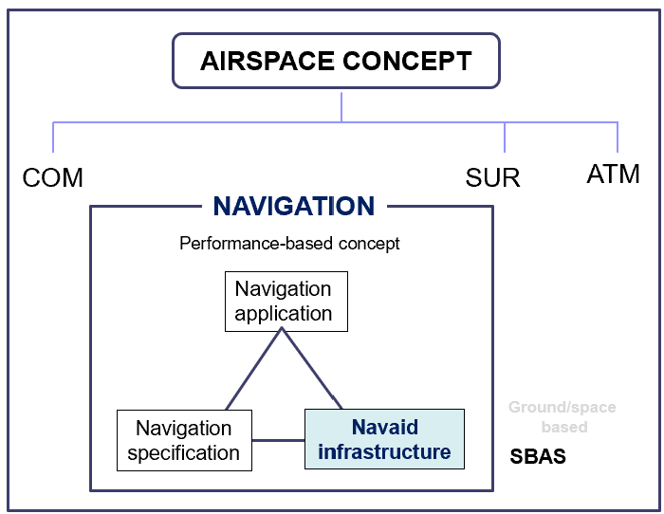
ABOUT SBAS: APPLICATIONS IN AVIATION AND BENEFITS

Slide 10
ABOUT SBAS: APPLICATIONS IN AVIATION AND BENEFITS
NPA Service Level
APV-1 Service level
PBN Navigation specifications other than RNP APCH for all flight phases
LPV-200 Service level
PBN Navigation specifications RNP APCH down to LPV minima down to 250ft
PBN Navigation specifications RNP APCH down to LPV minima down to 200ft
Oceanic
Remote Continental
Continental
En-Route
Continental
En-Route
Arrival
Approach
Departure
RNP 2
RNP 1
RNAV 2 RNP 1
RNAV 5 RNAV 2
RNAV 10
RNP 4
RNAV 5 RNAV 2
RNP APCH
RNAV 1, RNP 0.3
RNAV 1, RNP 0.3
Advanced RNP

Slide 11
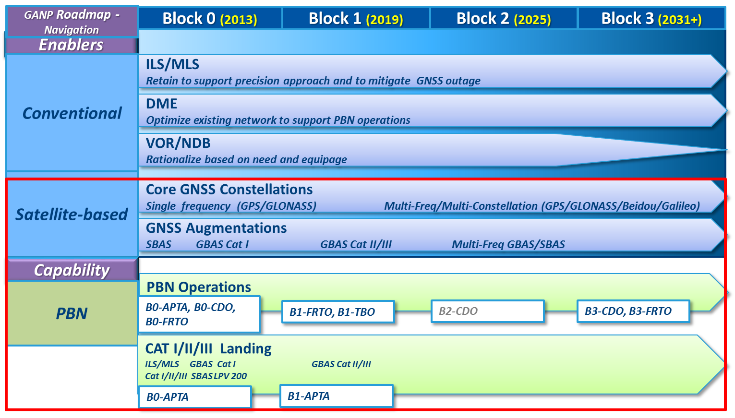
ABOUT SBAS: APPLICATIONS IN AVIATION AND BENEFITS
SBAS is a primary navigation system capable of supporting PBN operations within the framework of ICAO ASBUs

Slide 12
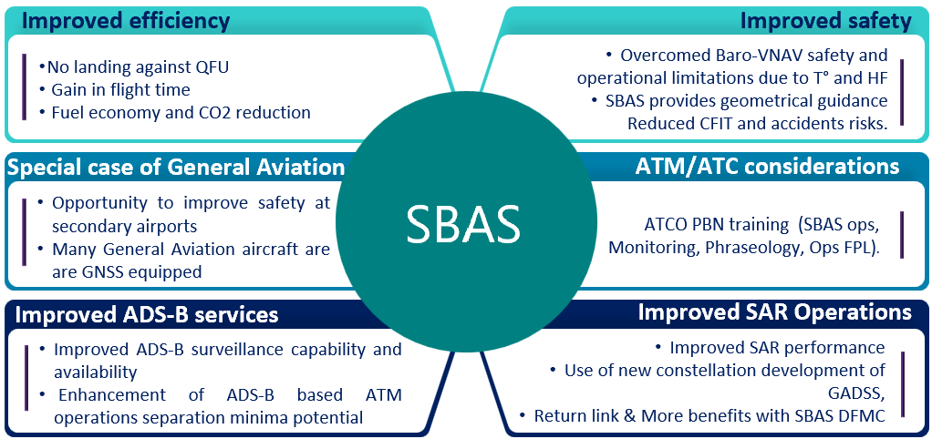
ABOUT SBAS: APPLICATIONS IN AVIATION AND BENEFITS

Slide 13

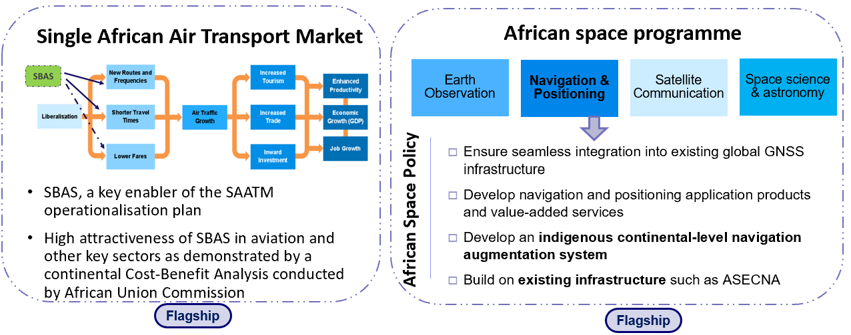
ABOUT SBAS: AUGMENTED NAVIGATION FOR AFRICA (ANGA)
AU Agenda 2063

Slide 14


ANGA programme
ABOUT SBAS: AUGMENTED NAVIGATION FOR AFRICA (ANGA)
GOALS FOR AFRICA
Prepare the future of Africa in a growing competitive international environment, in which space services provision go beyond by essence the natural borders of States
Develop the positioning of Africa in the worldwide value chain of satellite services provision
Provide high-added value satellite navigation services for the benefit of the African economy
Develop an African-wide own infrastructure and develop African capacities for its exploitation
Use, adapt and improve existing technologies
A VISION FOR AFRICA
A satellite navigation solution
developed and operated
by Africa for Africa

Slide 15
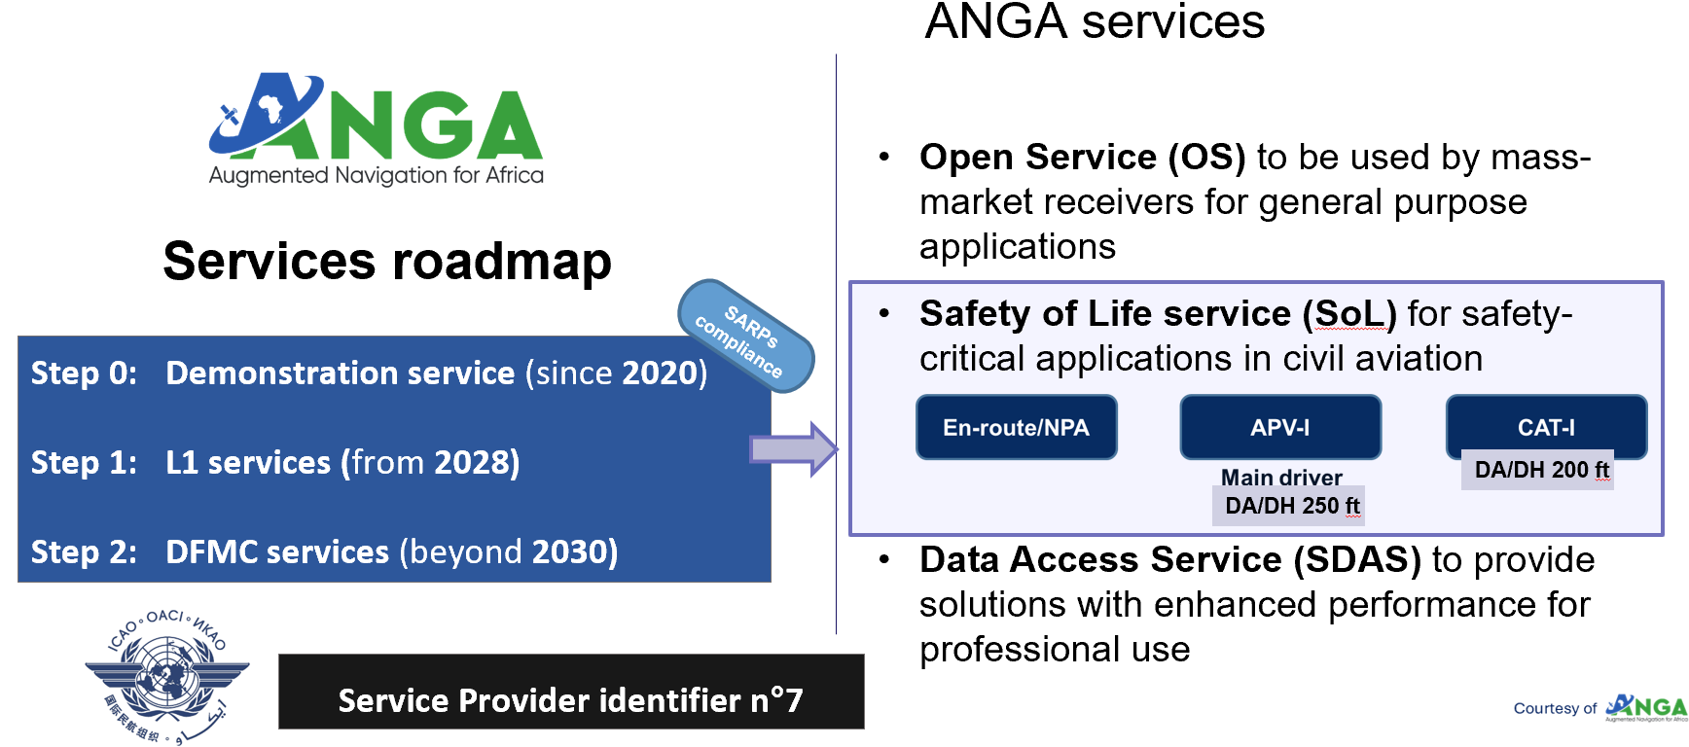
ABOUT SBAS: AUGMENTED NAVIGATION FOR AFRICA (ANGA)
15

Slide 16
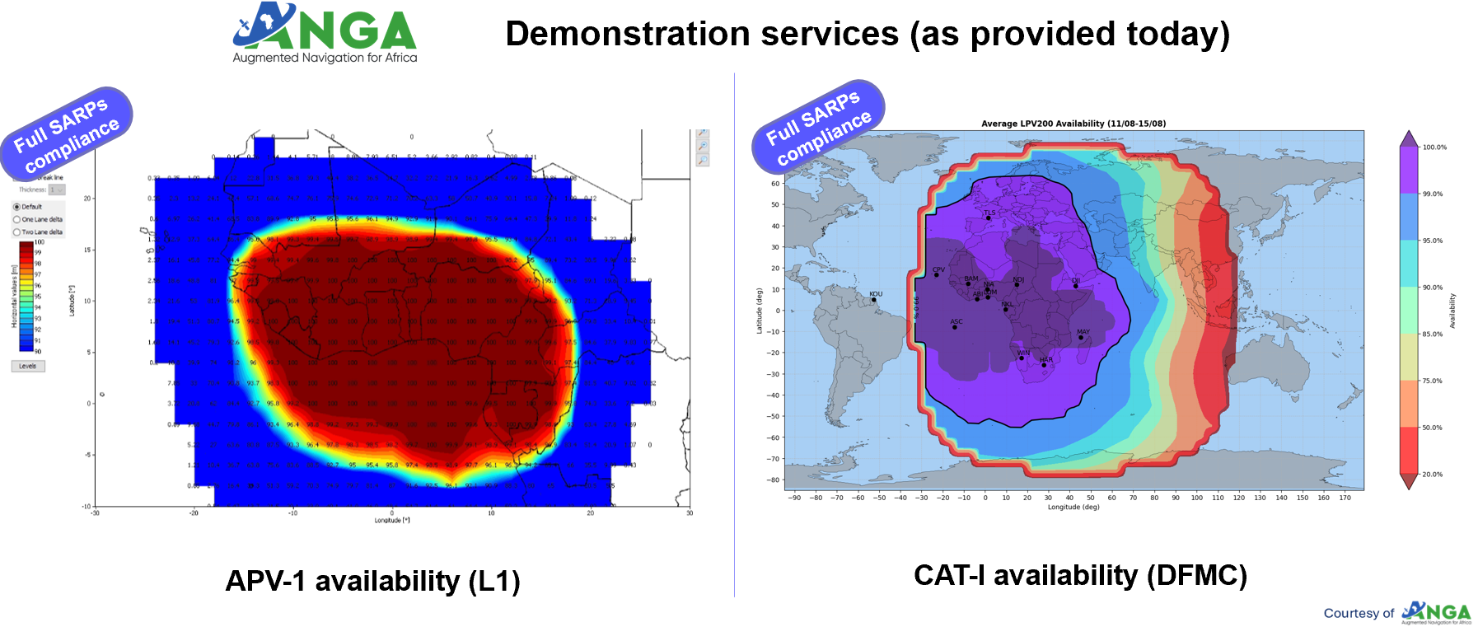
ABOUT SBAS: AUGMENTED NAVIGATION FOR AFRICA (ANGA)

Slide 17
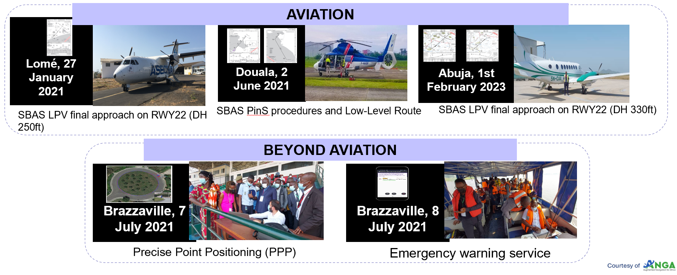
ANGA L1 demo service - Field demos
ABOUT SBAS: AUGMENTED NAVIGATION FOR AFRICA (ANGA)

Slide 18
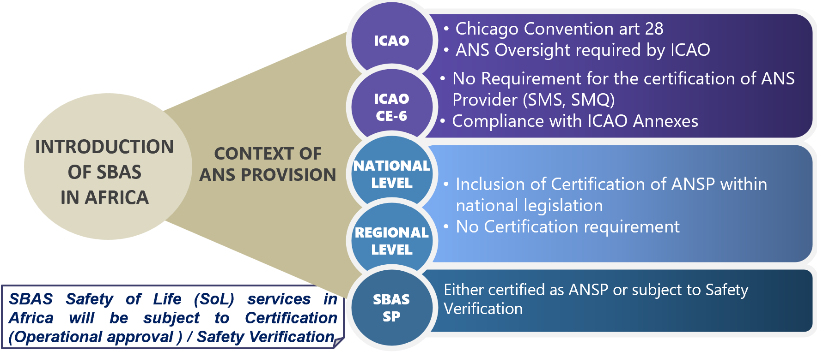
CONTEXT FOR THE IMPLEMENTATION OF SBAS IN AFRICA

Slide 19
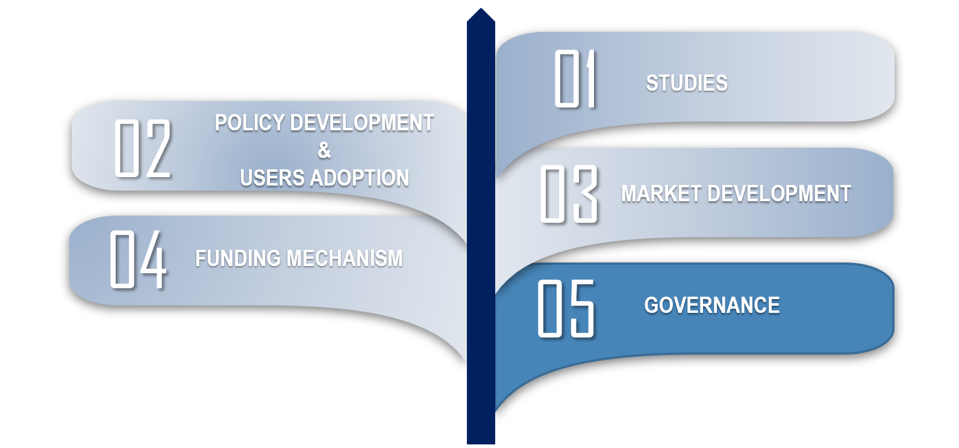
REQUIREMENTS FOR SBAS PROGRAMME IMPLEMENTATION

Slide 20
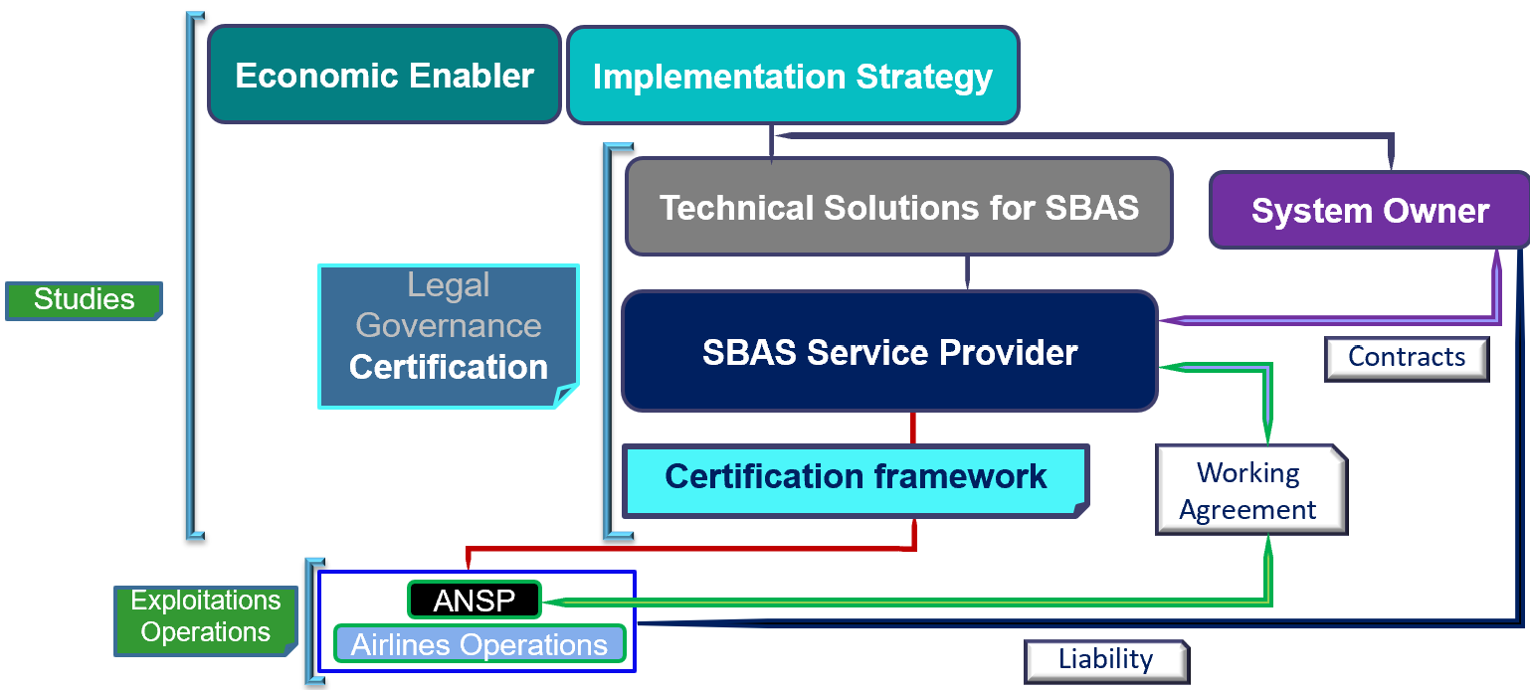
REQUIREMENTS FOR SBAS PROGRAMME IMPLEMENTATION

Slide 21
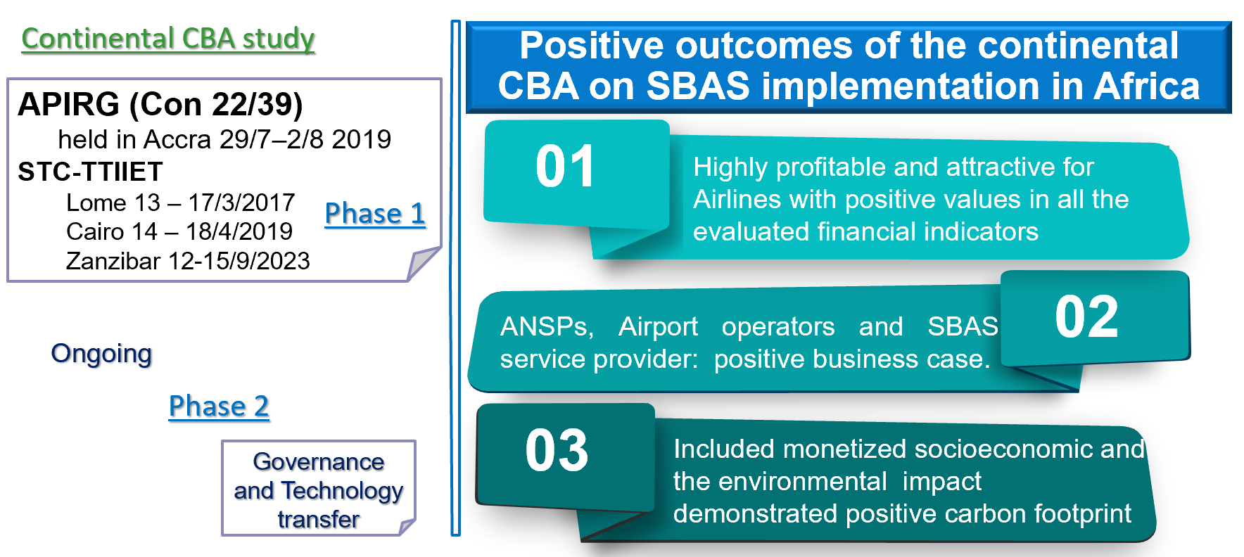
REQUIREMENTS FOR SBAS PROGRAMME IMPLEMENTATION

Slide 22
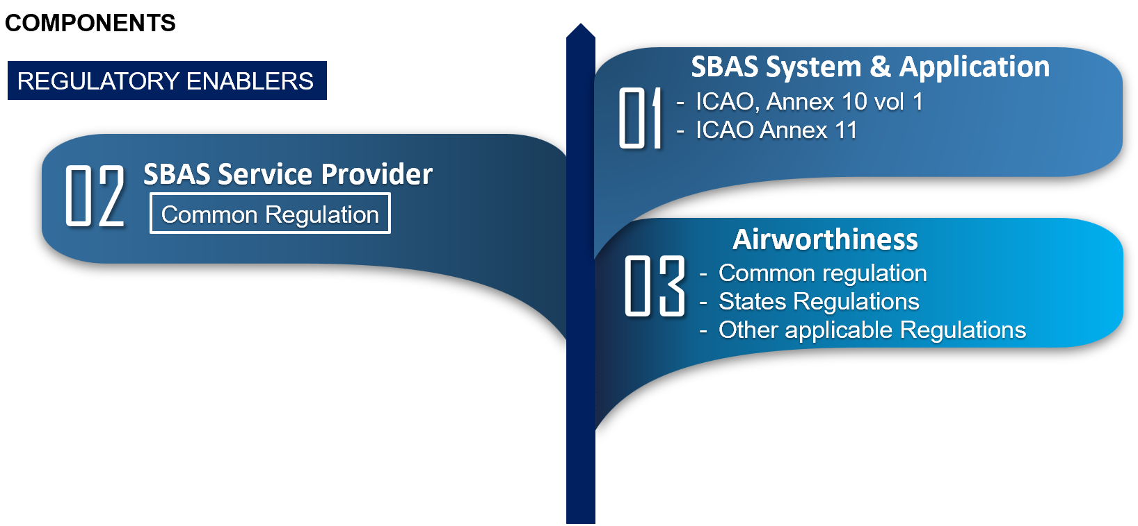
FRAMEWORK FOR THE CERTIFICATION/SAFETY VERIFICATION

Slide 23
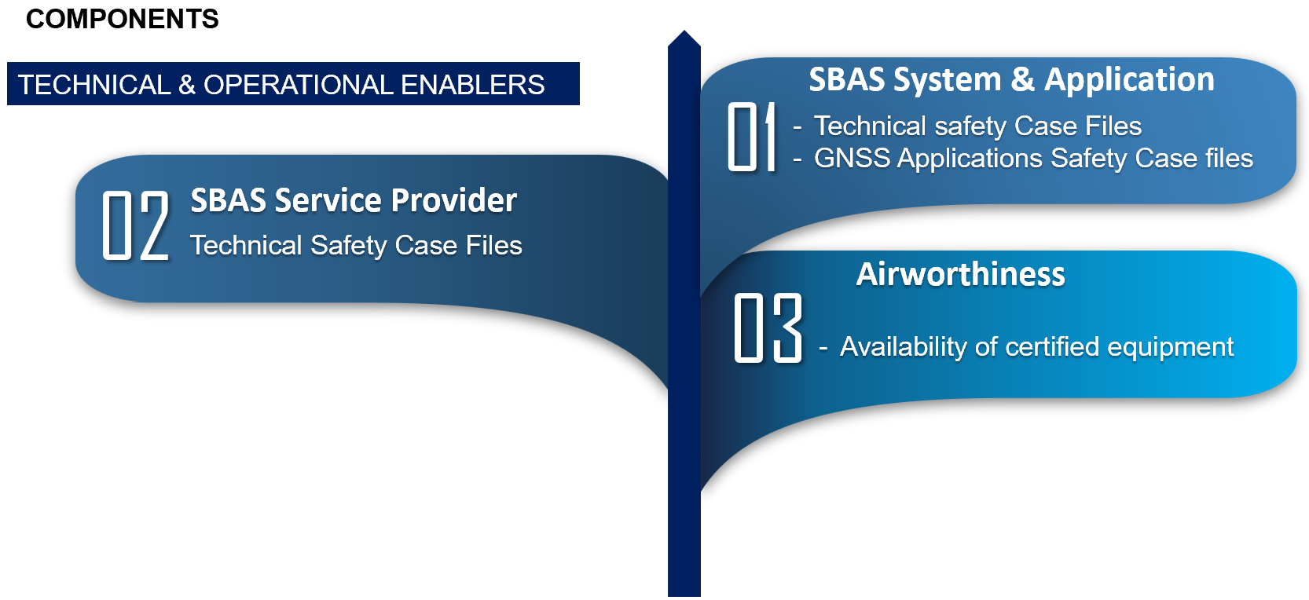
FRAMEWORK FOR THE CERTIFICATION/SAFETY VERIFICATION

Slide 24
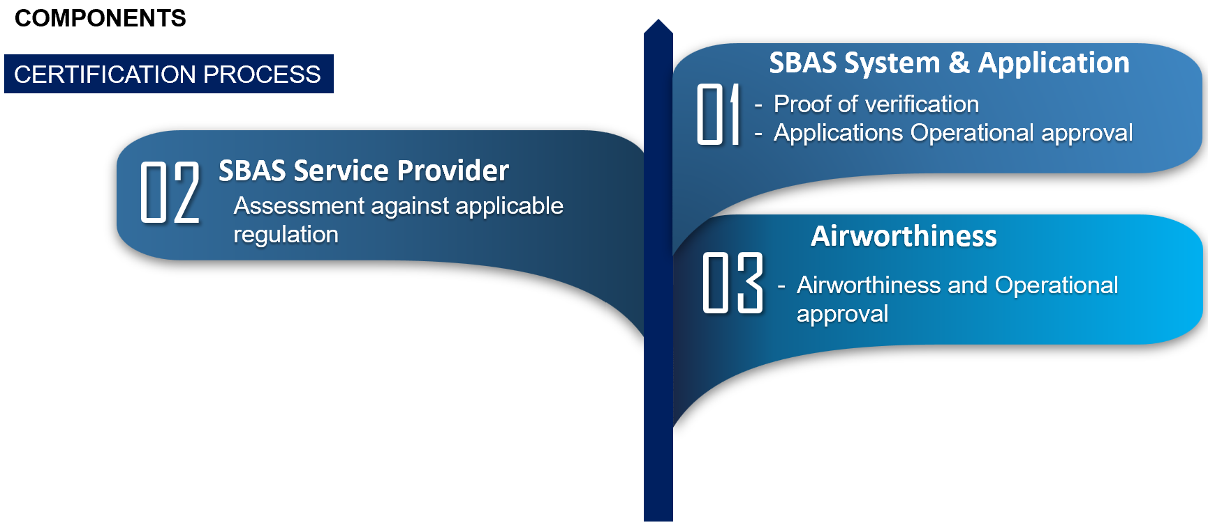
FRAMEWORK FOR THE CERTIFICATION/SAFETY VERIFICATION

Slide 25
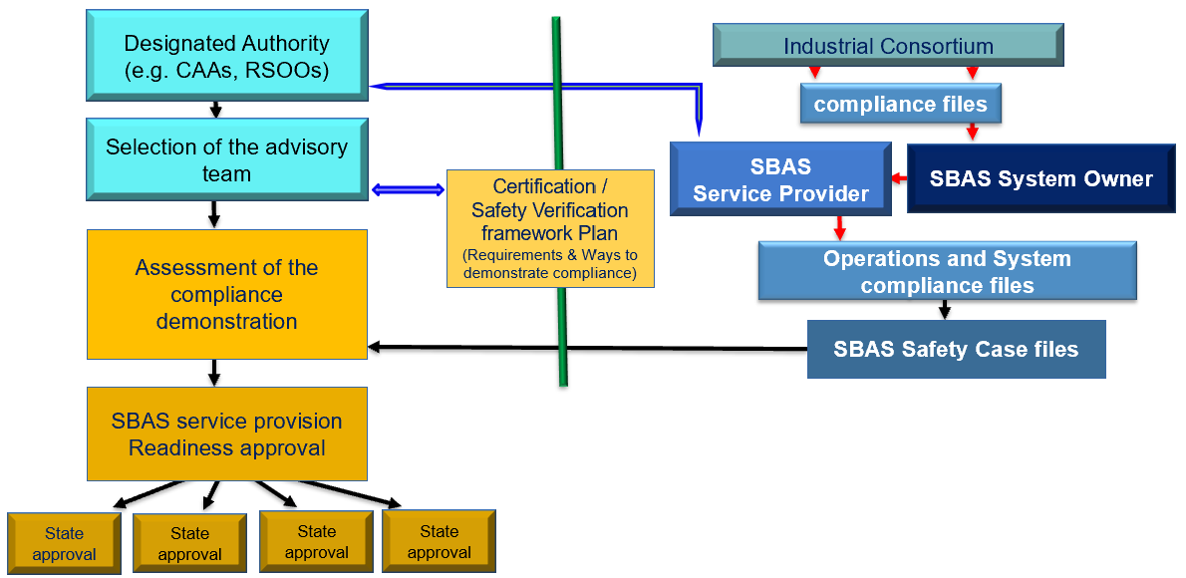
FRAMEWORK FOR THE CERTIFICATION/SAFETY VERIFICATION

Slide 26
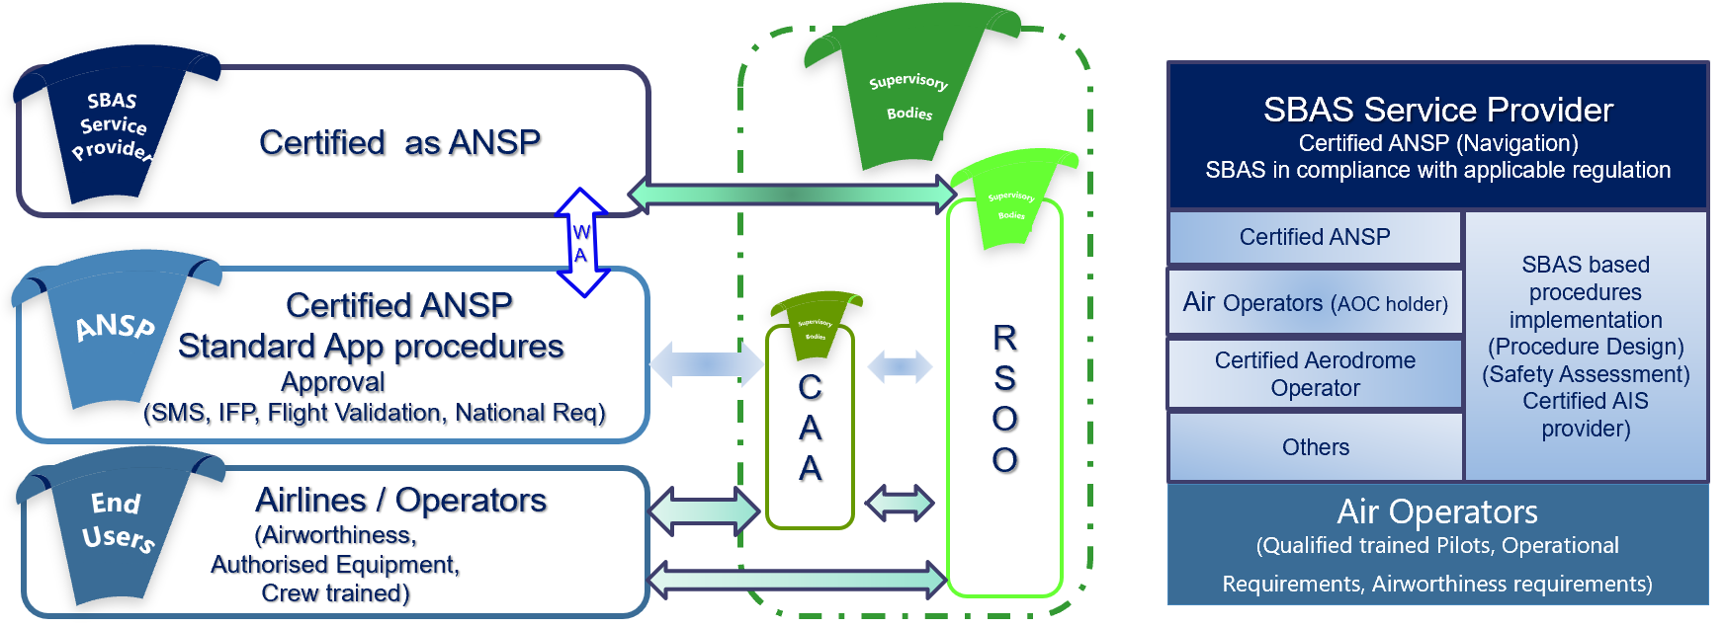
FRAMEWORK FOR THE CERTIFICATION/SAFETY VERIFICATION

Slide 27
CHALLENGES
ANSP
SBAS SP
Absence of continental legal and institutional frameworks to address the multinational nature of the SBAS services provision including the system safety analysis and certification and operational approvals.

Slide 28
CONCLUSION
Element of GNSS
Component of CNS infrastructure
Provision of SBAS fall in the frame of Air Navigation Services Provision
SBAS
Requires a new regional framework for a harmonized verification and operational approval of SBAS services
SBAS
governance
RSOOs, National Safety oversight structures and partners should work together in the view of a consensus based partnership for the implementation of certification/Safety Verification related processes.

Slide 29
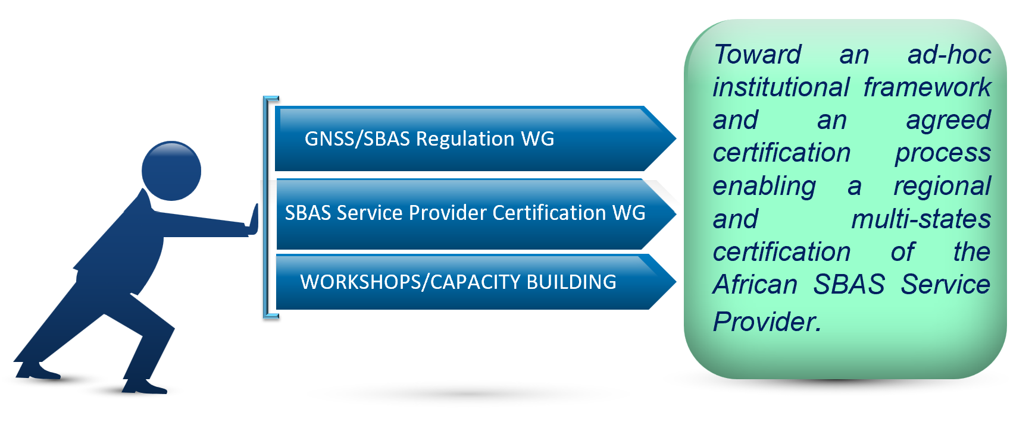
WAY FORWARD

Slide 30
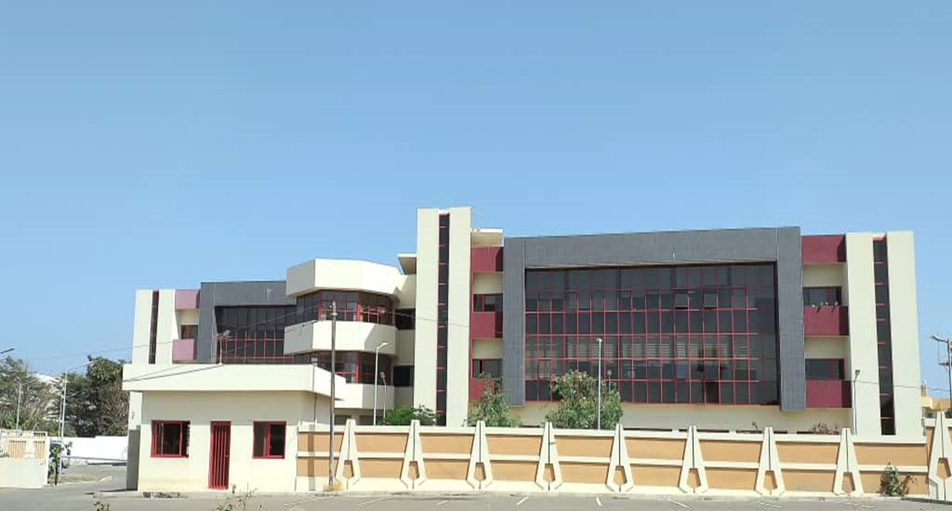






SatNav in Africa Support Programme III
Joint Programme Office (JPO)
      info@satnav-africa.com
      +221 33 865 40 28
      @SatnavAfrica
      SatNav Africa JPO
      www.satnav-africa.com
Thank You

