Slide 1
THE RPAS SAGA Where we were? Where are we? Where are we going?
Name of Presenter: Ibrahim Abdallah
RPAS Inspector
Tanzania CAA

Slide 2
Where we were?

Slide 3
TCAA RPAS Circular
January 2017 #2017
ICAO Circular 328 #2011

Slide 4
14th December 2018
the Civil Aviation (Remotely Piloted Aircraft Systems) Regulations
www.tcaa.go.tz

Slide 5
2020
2023

Slide 6
Where are we?

Slide 7
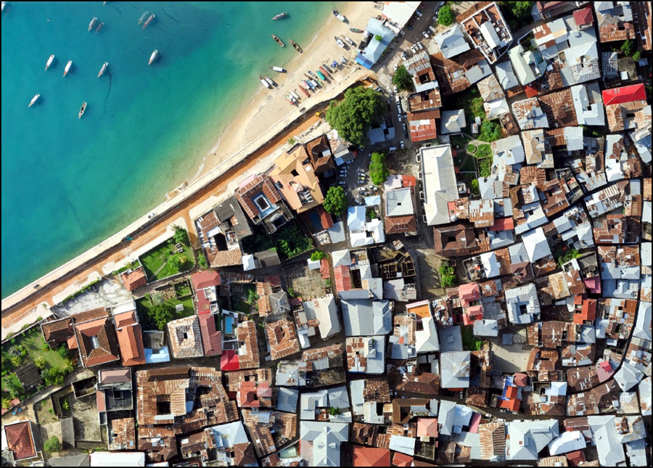
Remarkable Case Studies
Zanzibar Mapping Initiative

Slide 8
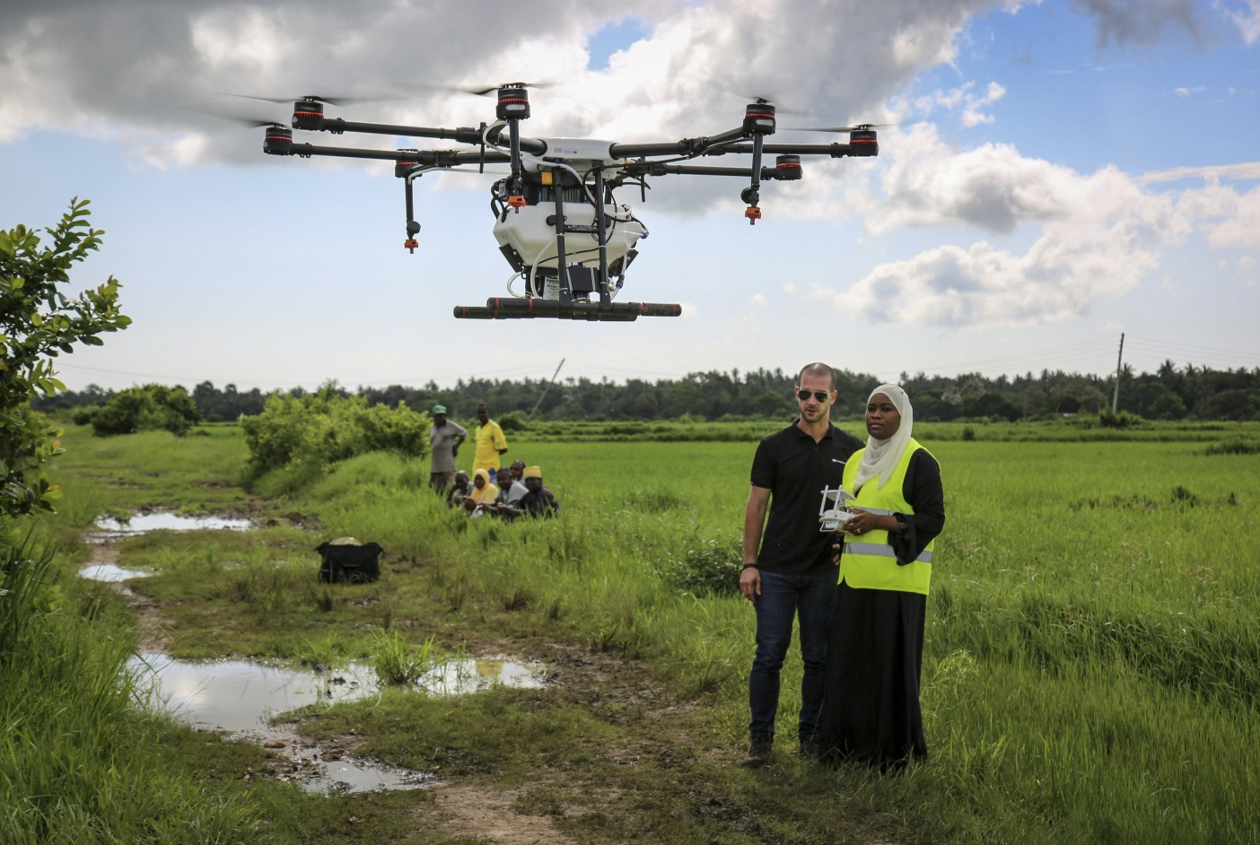
Remarkable Case Studies
Zanzibar Malaria Elimination Programme

Slide 9
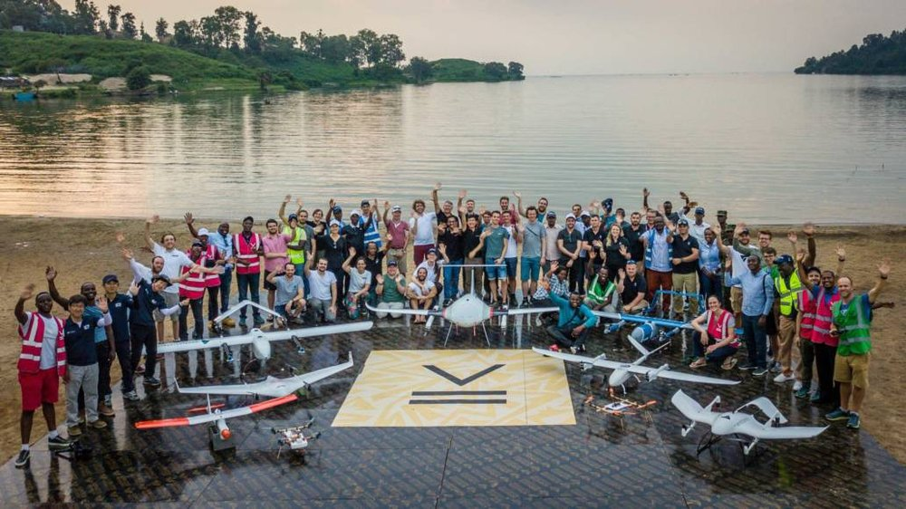
Remarkable Case Studies
Lake Victoria Challenge

Slide 10
Back to
RPAS Card License with (Verification, Ratings)
Application through Sofia PEL System
RPAS PEL TGMs
RPAS License Exams through the system
RPAS ATO
PEL Office

Slide 11
Back to
Civil Aviation Training Centre
1 training organization in Certification Phase 3
1 training organization in Certification Phase 1
1 training organization expecting to start certification process
Approved Training Organization

Slide 12
Back to
RPAS Register
Operator Register
RPAS Operation Notifications
RPAS Permits (Operations, Import and Export)
De-registration
Others
RPAS Permit Management System

Slide 13
Where are we going?

Slide 14
ROC
Integration

Slide 15
Adoption of Annex 6 Part IV
Amendment 110 to Annex 8

Slide 16
