Slide 1
Role of technology in detecting Inflight Pilot Incapacitation
Dr. Mkwizu

Slide 2
Outline
CAM Overview
Basic Aeromedical Principles
Research Study

Slide 3
CAM
CENTRE FOR AVIATION MEDICINE

Slide 4
Revolutionize Practice of AvMed in the EAC - Region
Ensure Compliance of ICAO SARPs, harmonized Regulations and TGMs
Provision of Continuous AvMed training
Achievements

Slide 5
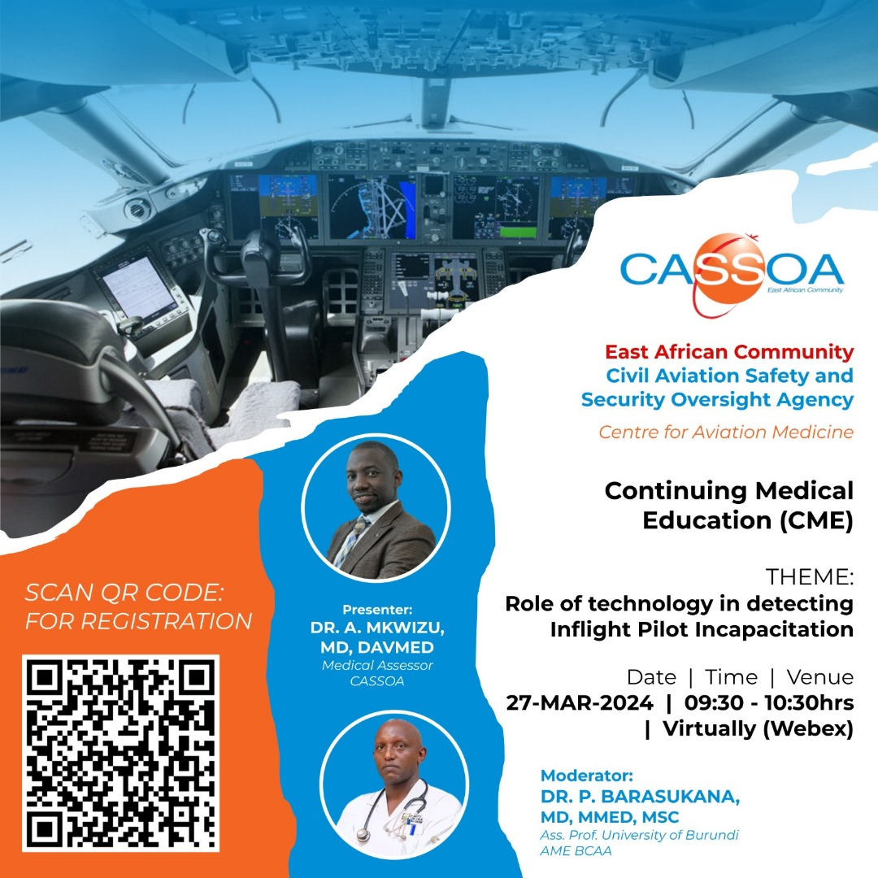
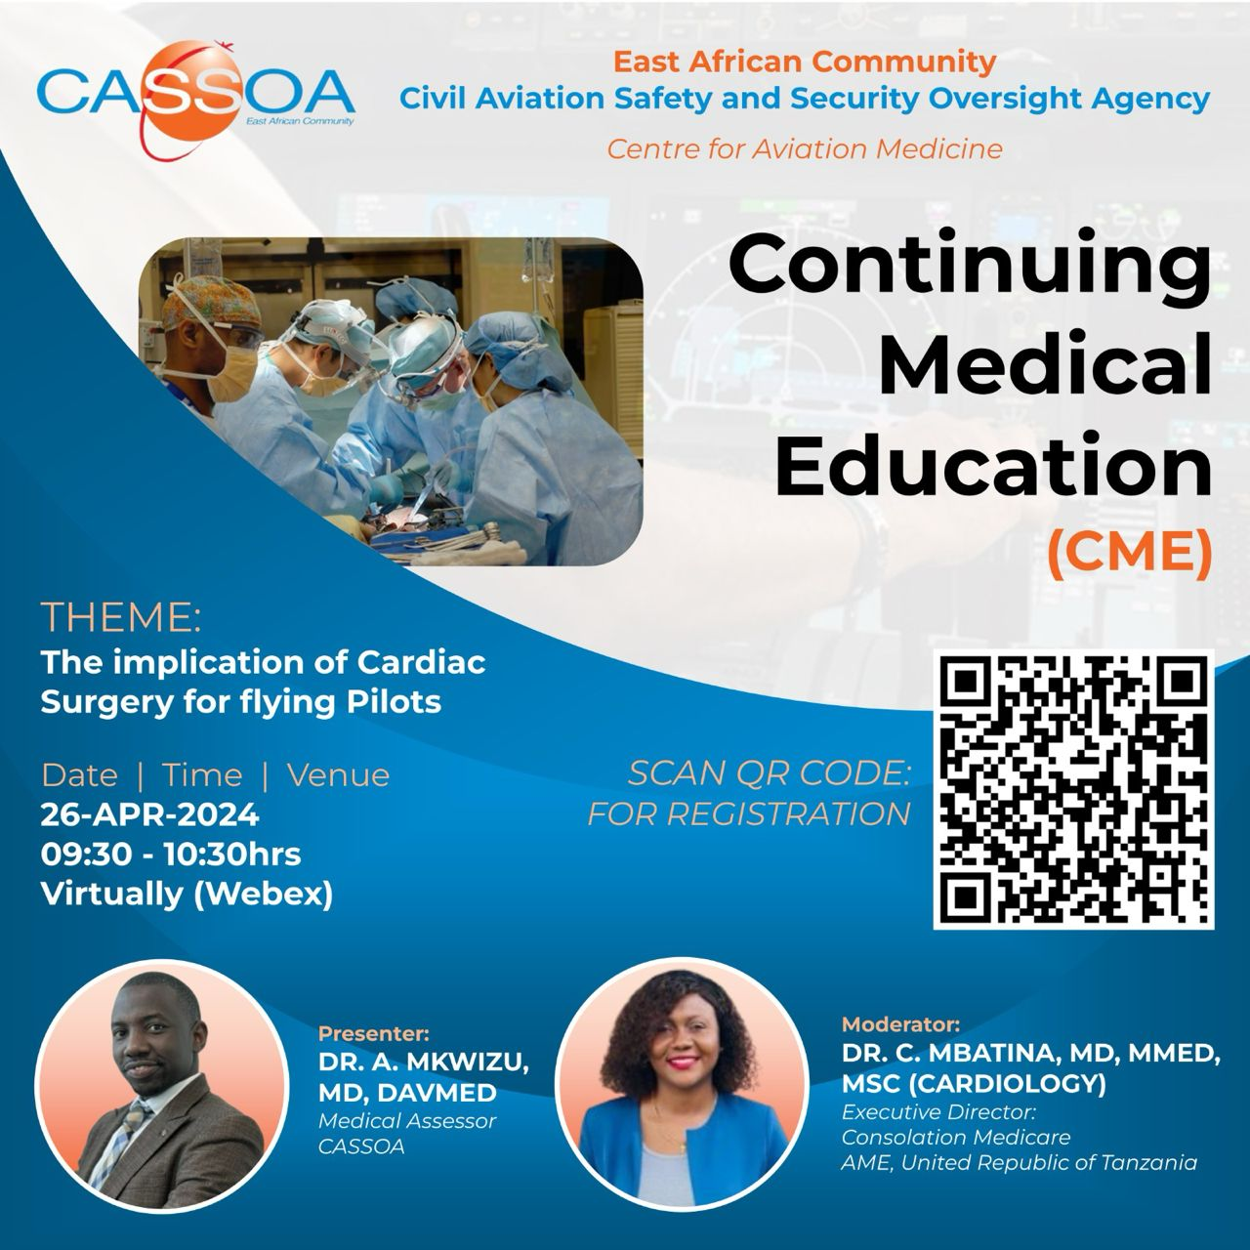
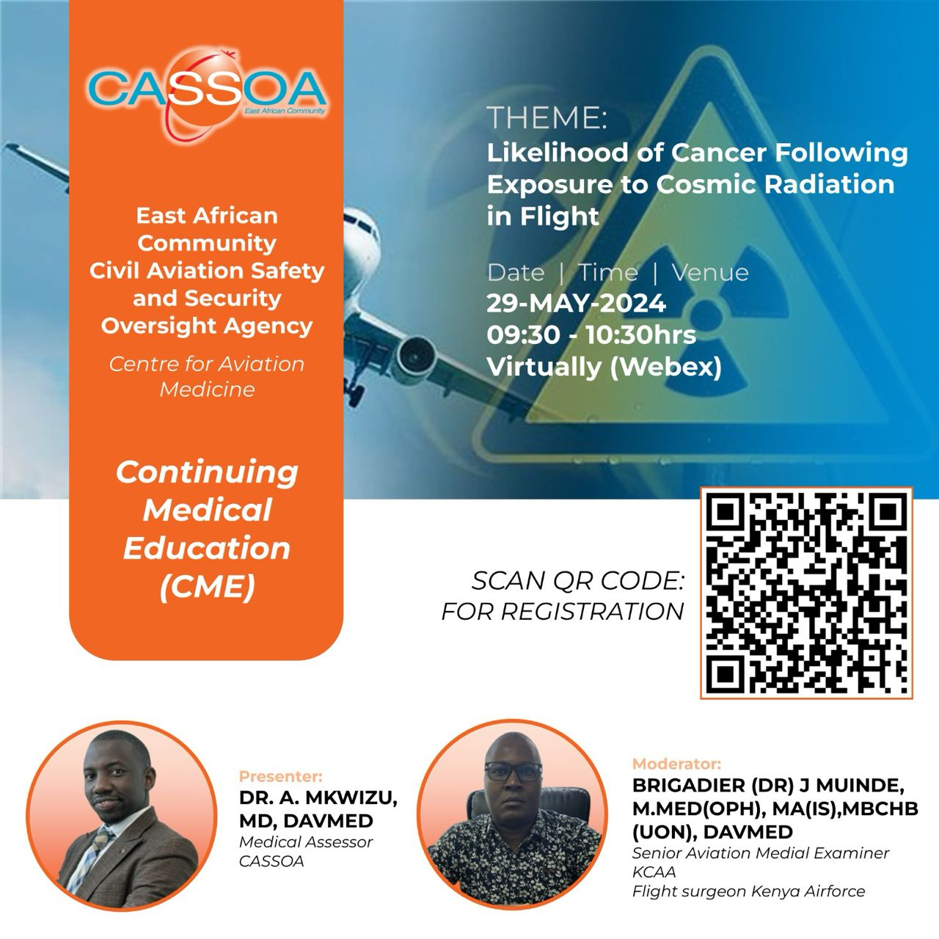

Slide 6
Statistical
Significance
Breast Cancer Studies

Slide 7
Conduct Research on human heath capacities among Aviators
Support in implementing Public Health programs
Strengthens partnerships between CAAs and Medical Institutions
Achievements

Slide 9
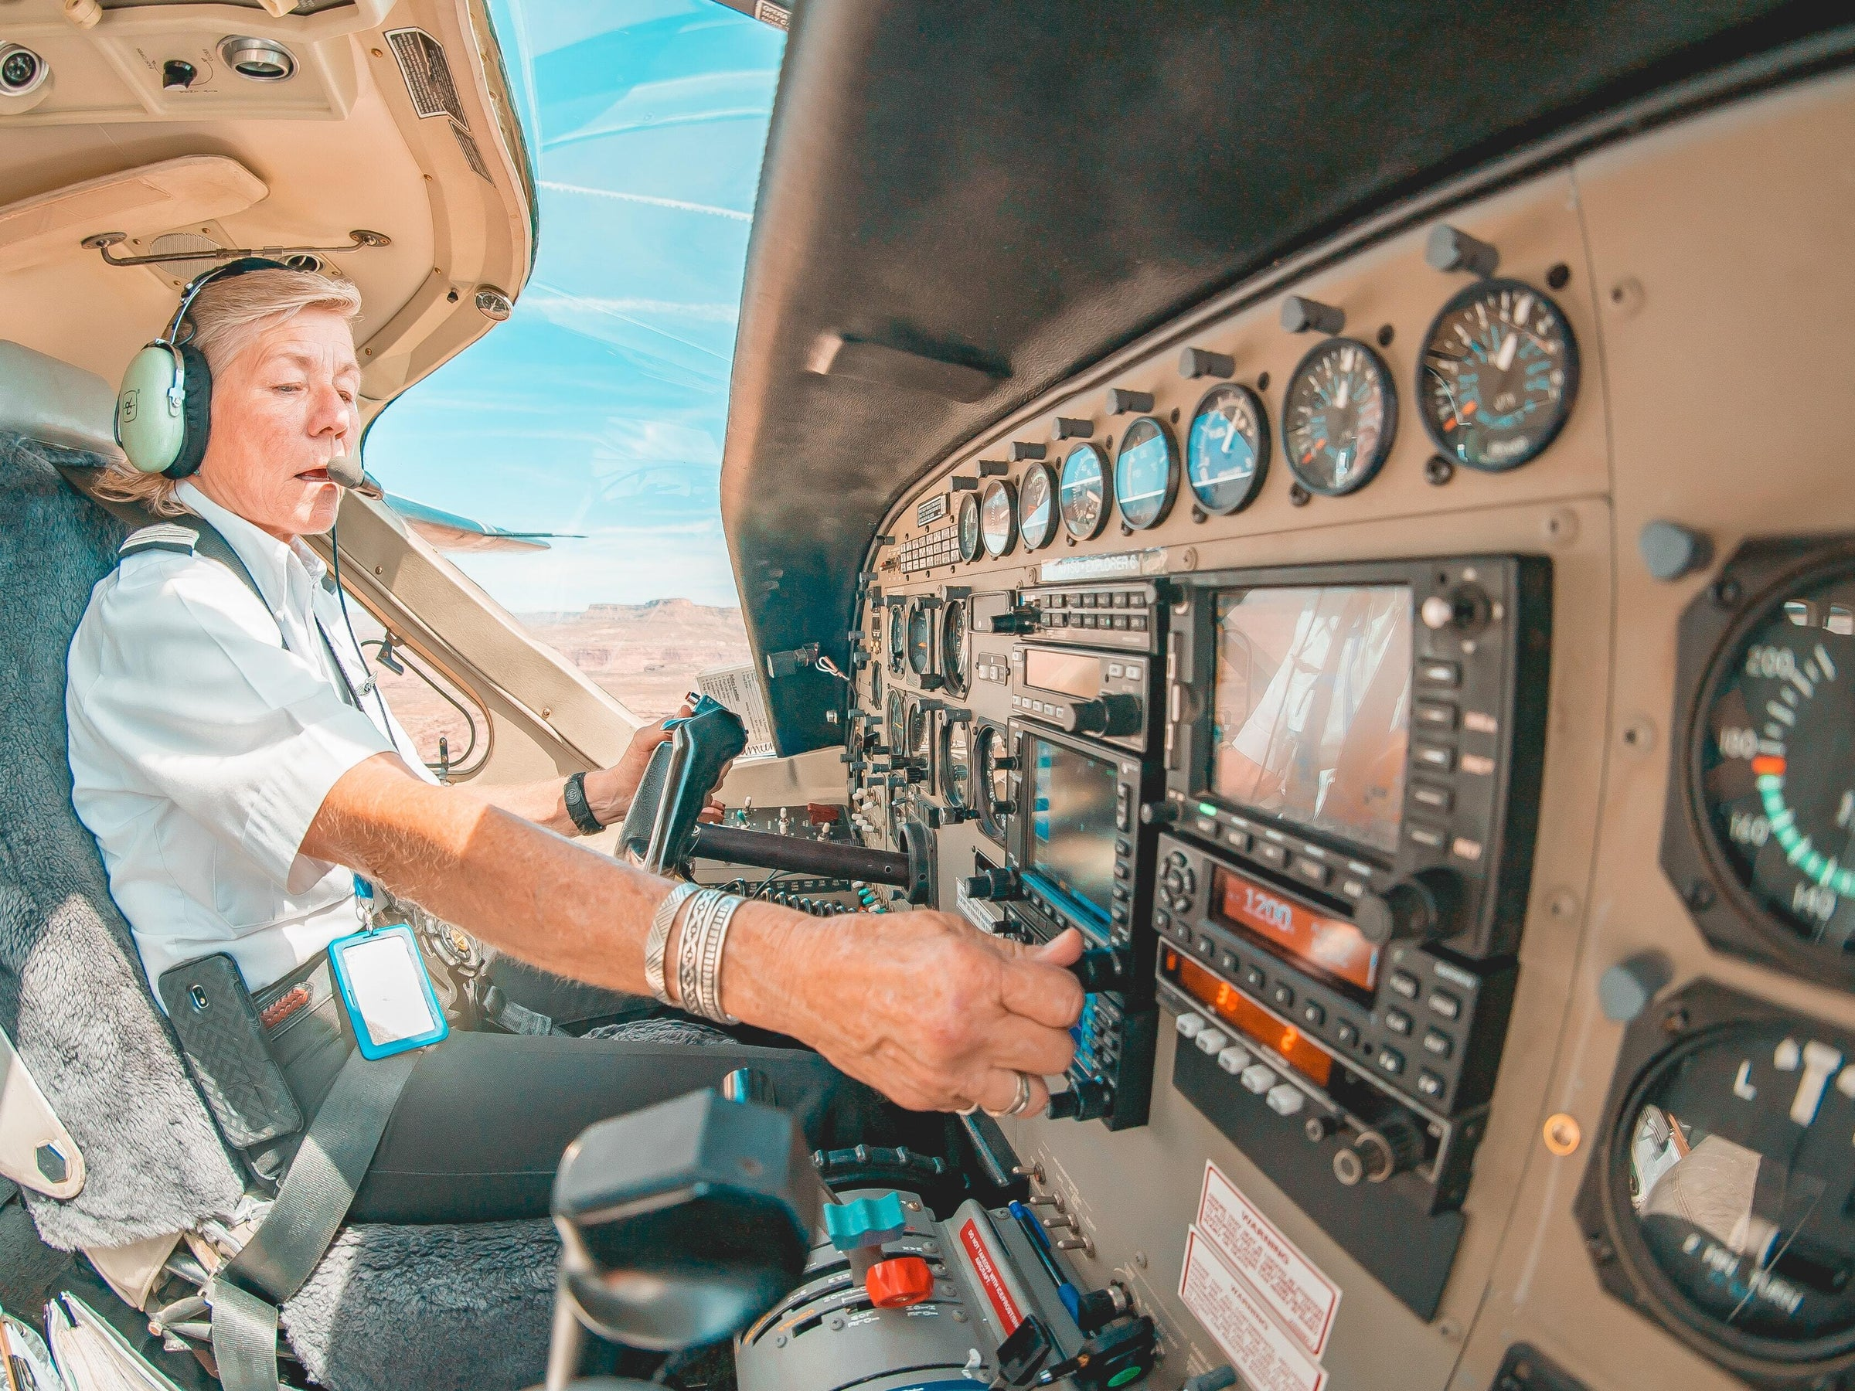
HUMAN-MACHINE INTERACTION

Slide 10
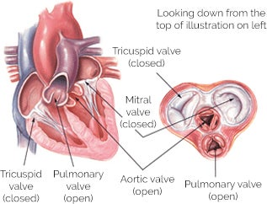
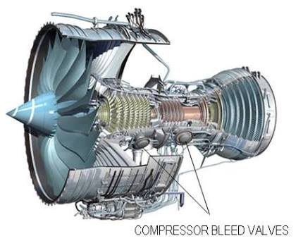
INSEPARABLE
LINK
EITHER VALVE FAILS WE’LL END UP WITH THE SAME OUTCOME

Slide 11
Future Demands
Do Airlines wish to reduce operational costs by reducing crew number?
Do we need two pilots for long haul commercial flights in future?
Can technology assess and intervene for an incapacitating pilot?
Does 1% Rule hold with advanced technology?

Slide 12
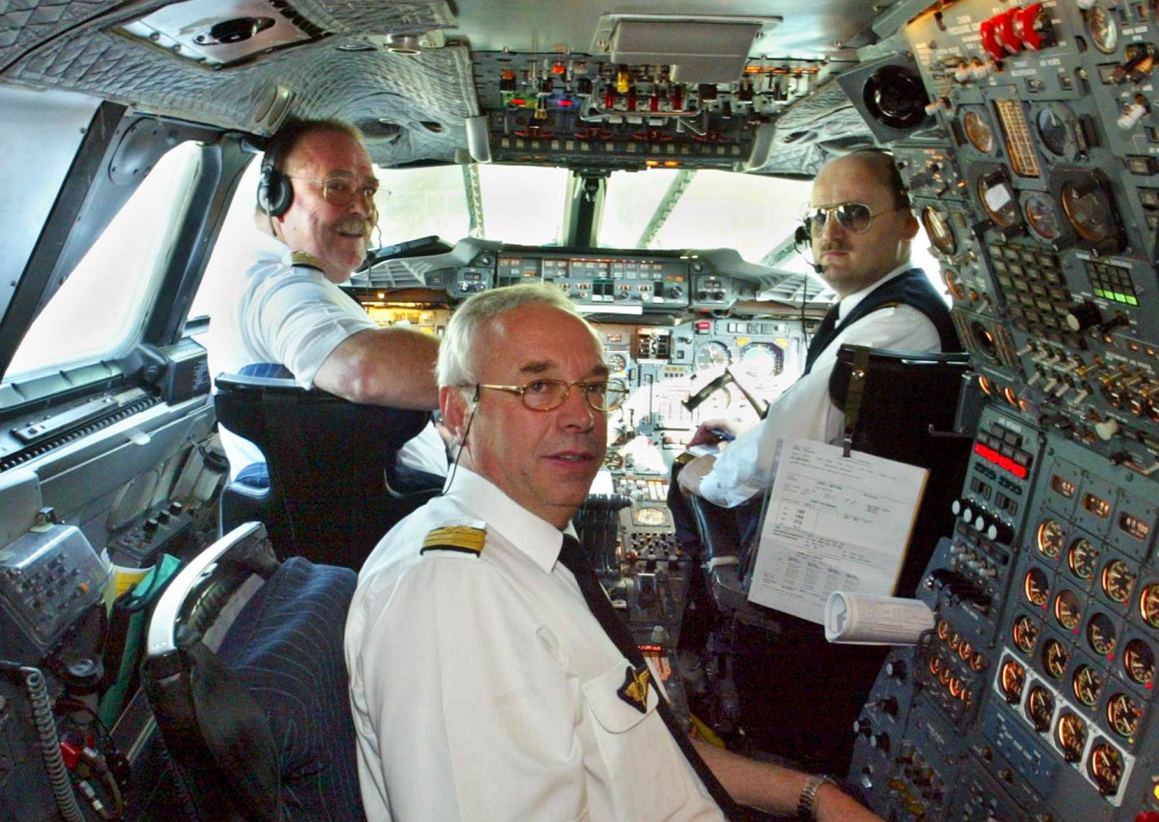
NEXT STOP
IT WAS POSSIBLE
TECHNOLOGY

Slide 13
Consideration
Current 2 men Crew
PF incapacitates and hands over to PM
PF incapacitates and fails to handover to PM
Future 1 man Crew
PF recognize failure and allows the System to take over
PF do not recognize failure, the system senses incapacitation and takes over
CRITICAL

Slide 14
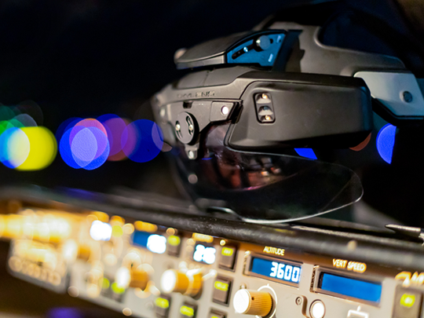
Autonomous Aircrafts
REQUIREMENTS
In-flight Medical Diagnostic Devices

Slide 15
MITRE -CAASD
TCAS
ADS-B

Slide 16
Blood Oxygen Levels
Cardiac Waveforms
Brain Activity
Movement and Muscle Tone
Respiratory Waveform
Responsiveness and Speech
Sudden Cardiac Death
Sleep
Epileptic Seizure
Stroke
Hypoxia
Acute Pain Syndrome
Failure Modes
Signals

Slide 17
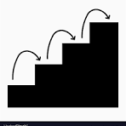
Maturity Assessment Criteria

Slide 18
Validity Assessment Criteria

Slide 20
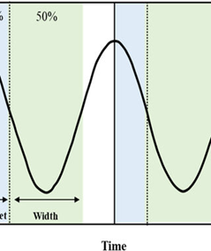

Slide 25
Future Research for this study
Identify potential algorithms incorporating physiological signals performance in flight environment using multiple devices.
Lab testing to assess physiological monitoring devices focusing on usability and testing
Statistical simulation to determine expected risk reduction in flight missions
Flight deck testing of physiological monitoring system for accuracy in aviation environment
Facilitating of community and industry Engagement to fill a critical knowledge gap on these devices

