Slide 1
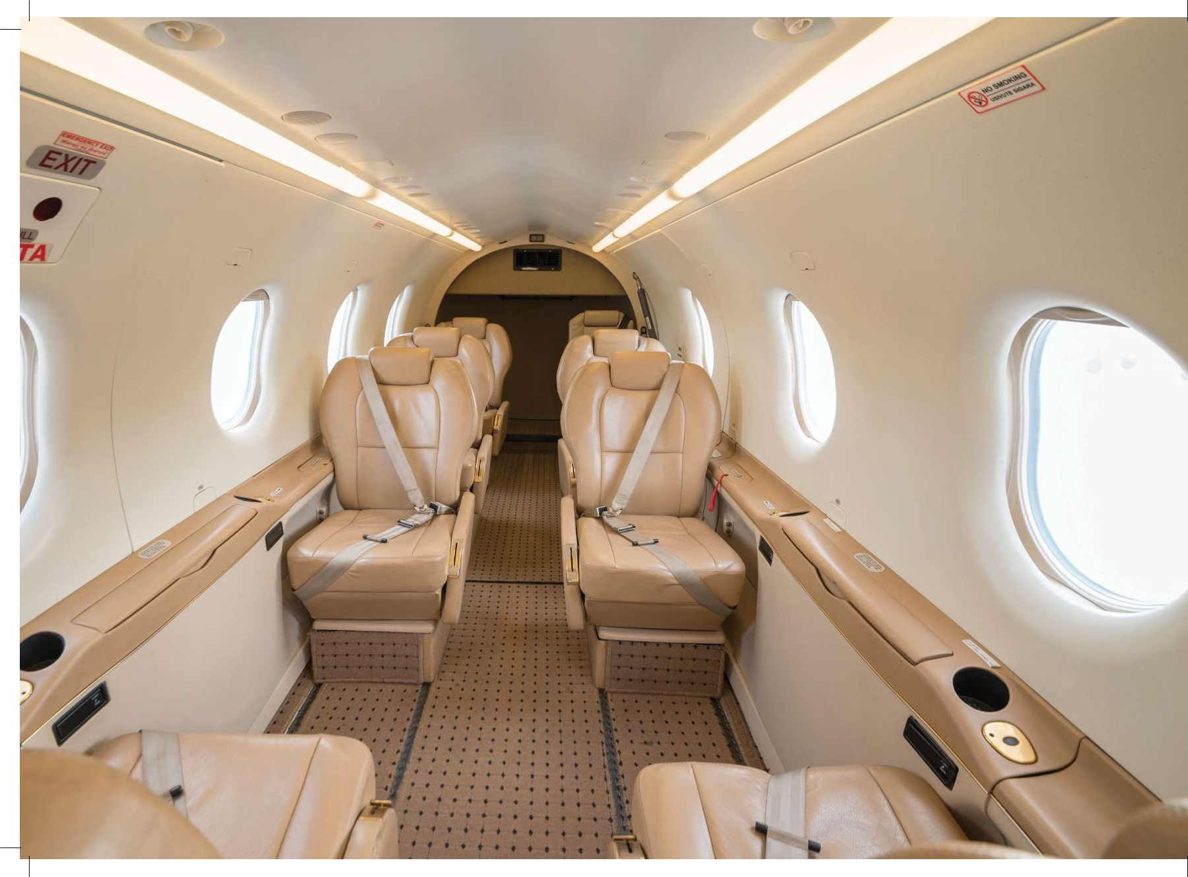
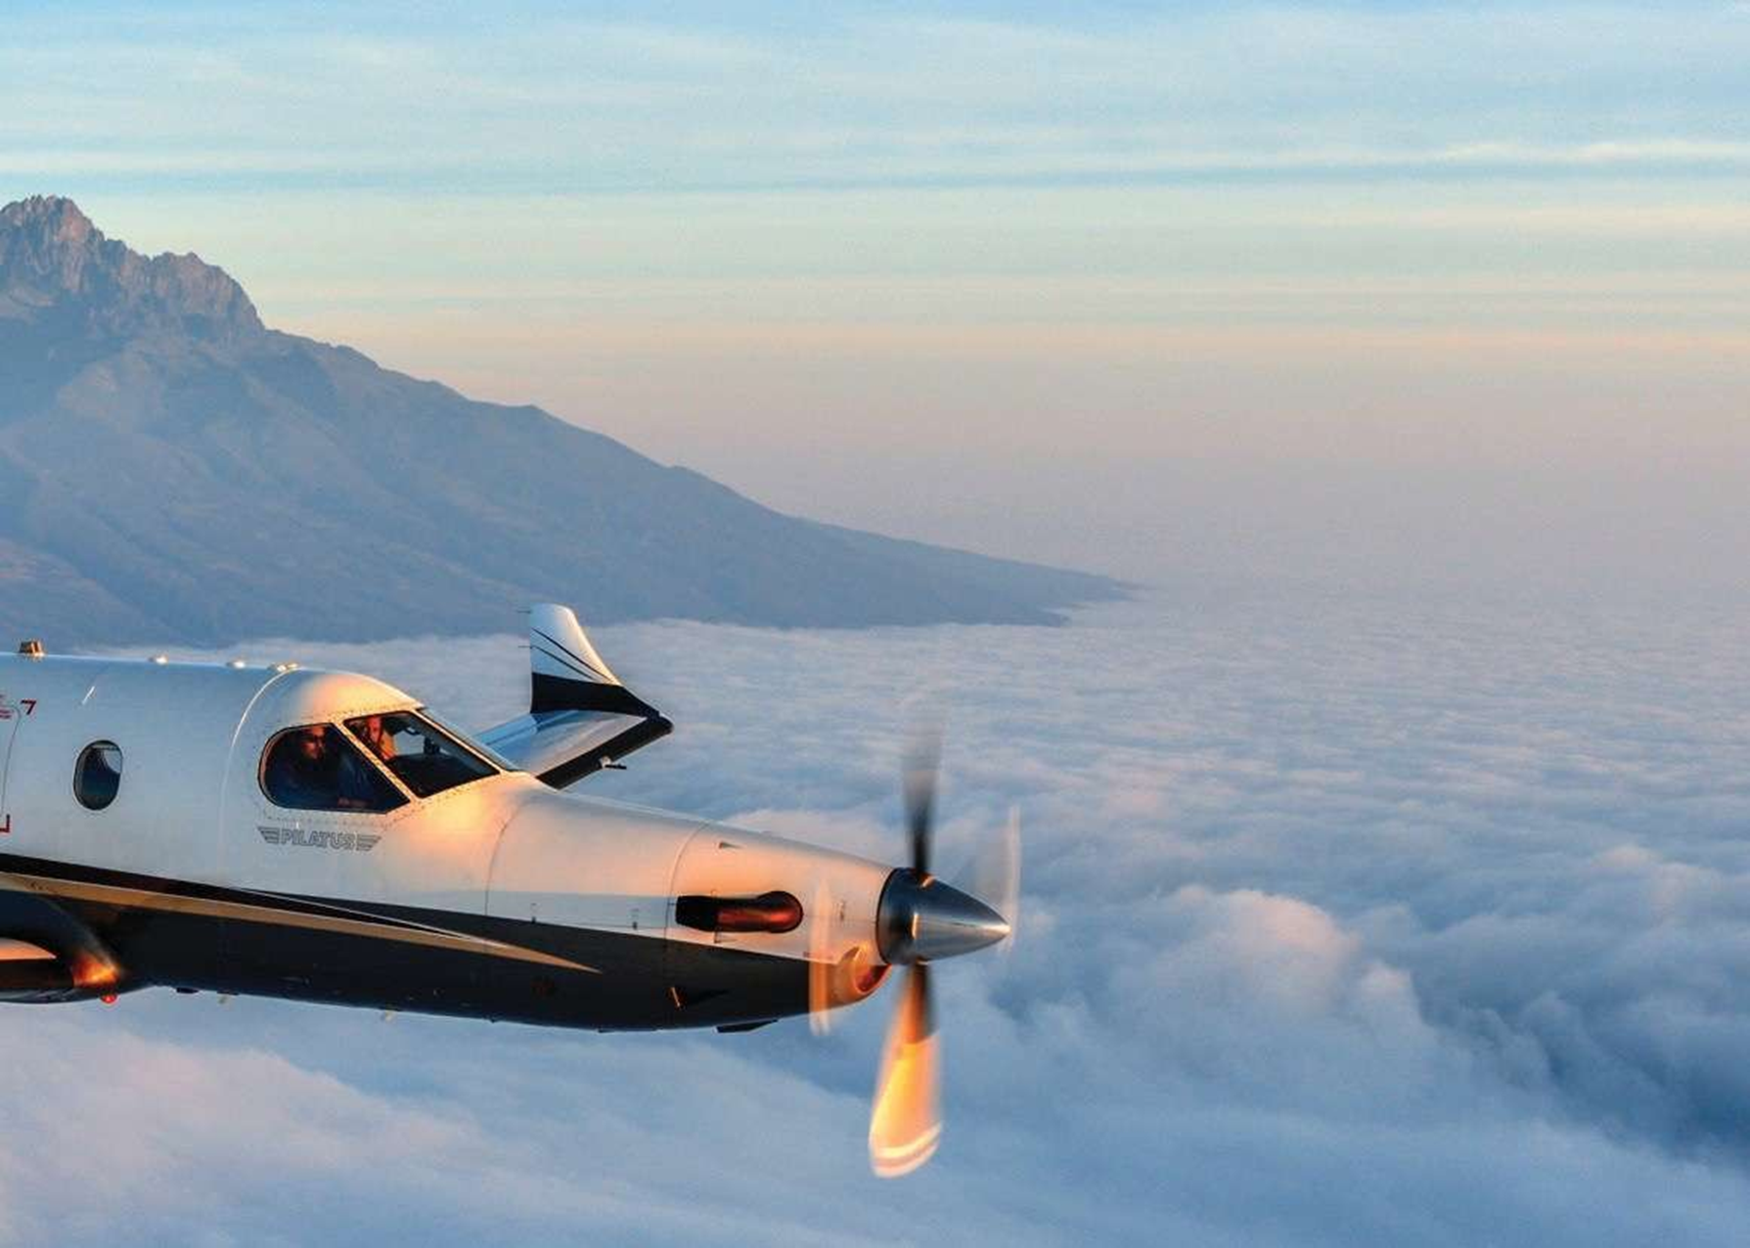
Notes:
Coastal Air is a Tanzanian airline that was established in 1987 and now has 14 Cessna caravans and 4 PC12 aircraft

Slide 2
Why is Safety Culture Important?
For every single fatality there are at least 300,000 at-risk behaviors (activities that do not exist in safety reporting system)
Notes:
Why is safety culture important?
There are approximately 300,000 at risk behaviours before a fatality. This is why a culture of actively reporting hazards in a non-punitive environment is important – by working together we can prevent hazards from becoming incidents or accidents.
We have all stepped over a cable or walked over a wet floor when inside a building. But how many times will it take until we trip or fall? Is there a culture of acceptance in our routine?

Slide 3
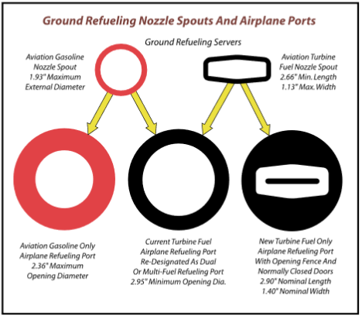
There isn’t a person alive who hasn’t made a mistake. But I’m positive you’ll never make this mistake again. That’s why I want to make sure that you’re the only one to refuel my plane tomorrow. I won’t let anyone else on the field touch it.”
Just Culture
Improves Communication
Notes:
Bob Hoover- American test pilot

Slide 4
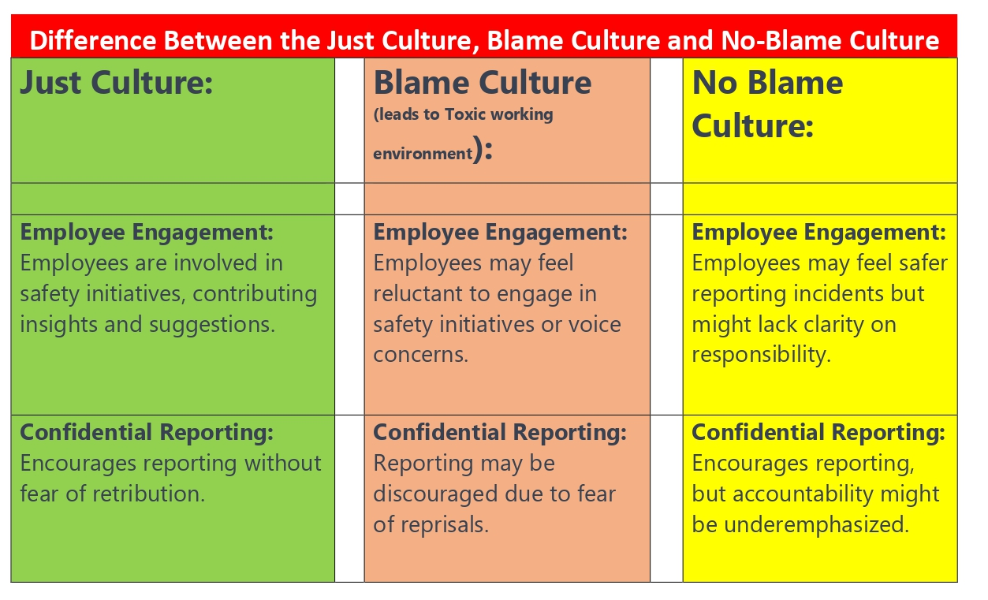
Just Culture = Employee Engagement

Slide 6
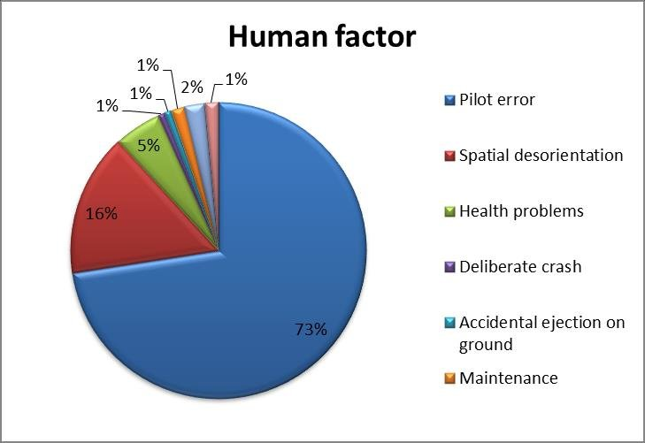

Good Communication can
Reduce Human Factor Errors

Slide 7

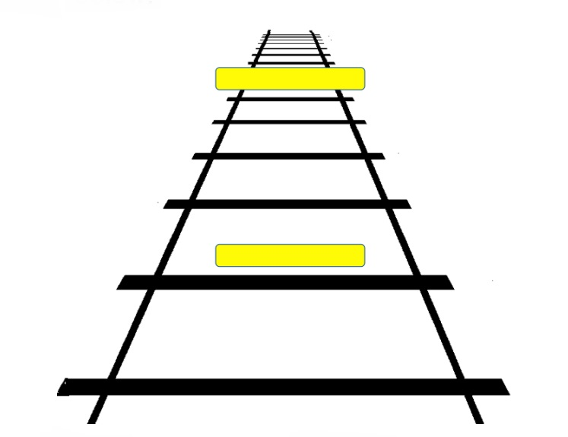
Appearances can be Deceptive

Slide 8
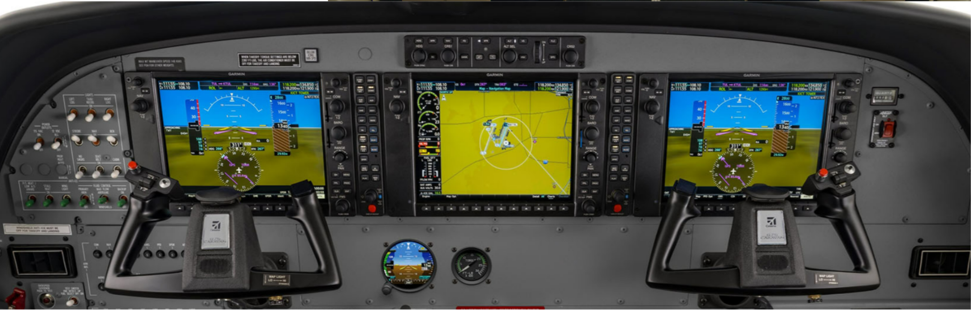
Using Technology to Enhance Safety
Garmin Electronic Stability Protection (ESP)
Notes:
All our new 7 C208EX aircraft have Garmin electronic stability and protection (ESP). This is similar to advanced safety systems found on new Airbus and Boeing jet aircraft.
ESP is a safeguard created to maintain safe, stable flight. It monitors the aircraft’s flight condition, functioning independently of the autopilot, and it applies a control force toward stable flight whenever pitch or roll deviations exceed recommended limits. ESP can also recognize when under-speed or overspeed conditions are about to occur — such as a stall or too-steep of a descent — and it makes appropriate adjustments to the controls. Plus, if the system detects that ESP has been activated for a specified period of time, the autopilot will engage with the flight director in level mode to bring the aircraft back to level flight.

Slide 9
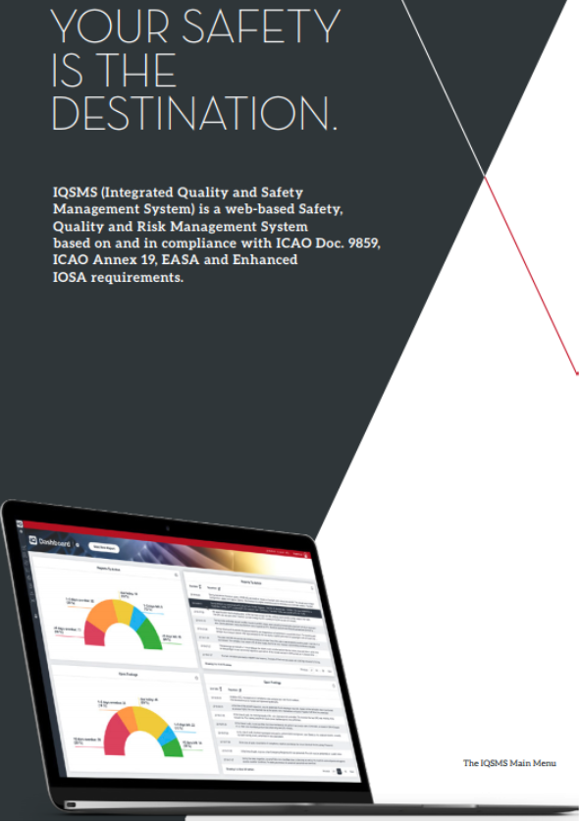

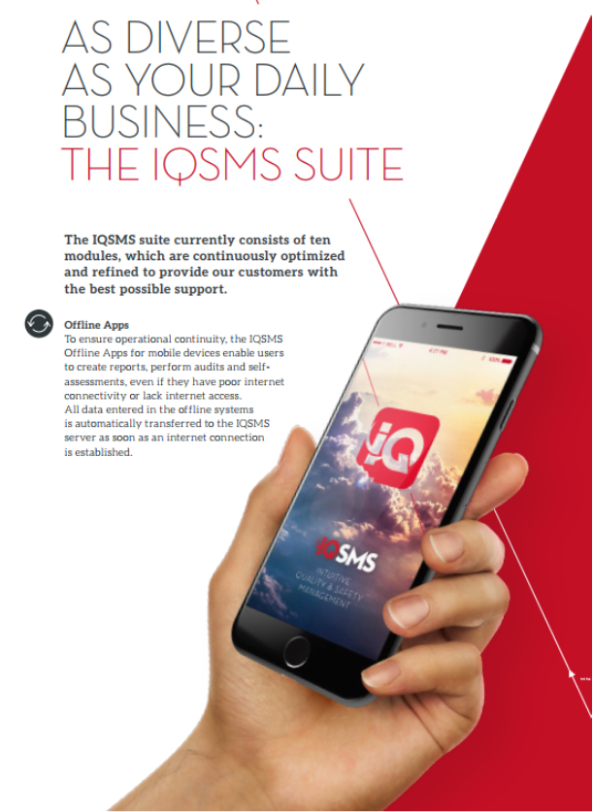
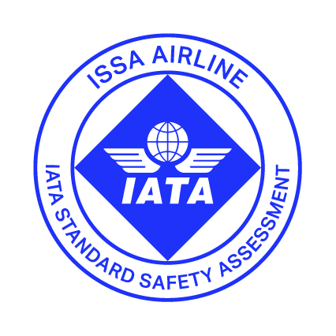
Using Technology to Enhance Safety
Notes:
Coastal Air are committed to continuously improving safety standards for everyone by investing in technology that is that only fit for purpose, but also adds value to our operation, and reassures stakeholders that safety is our number 1 priority.
IQSMS is an airline industry-proven system that improves efficiency and effectiveness by providing an easy-to-use safety reporting system and an automated internal audit process that ensure the highest level of safety and compliance is maintained.

Slide 10
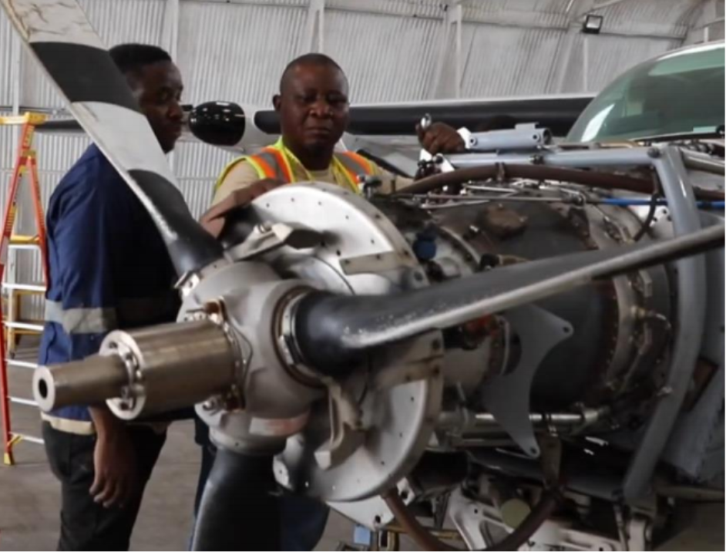
IATA Approved Aircraft Maintenance
Notes:
Coastal Air have a dedicated team of licenced engineers to ensure all our aircraft maintenance requirements can be resolved at the earliest opportunity.
Coastal Air also use a specialist engine consultant to monitor the health status and performance of all our aircraft engines at all times. In the event there is any anomaly, the Coastal Air maintenance department and accountable manager will immediately be sent a message to ensure immediate action can be taken.

Slide 11
Safety - Stakeholder Engagement
Notes:
Coastal Air collaborated with Geita Gold Mine to contact a full scale an emergency response drill exercise to test response times and highlight areas of improvement – At Coastal Air, we believe practice makes perfect.

Slide 12

Questions?

