Slide 1
LOC-I and UPRT Workshop
Captain Ed Givens
Boeing 737 Senior Technical Pilot

Slide 2
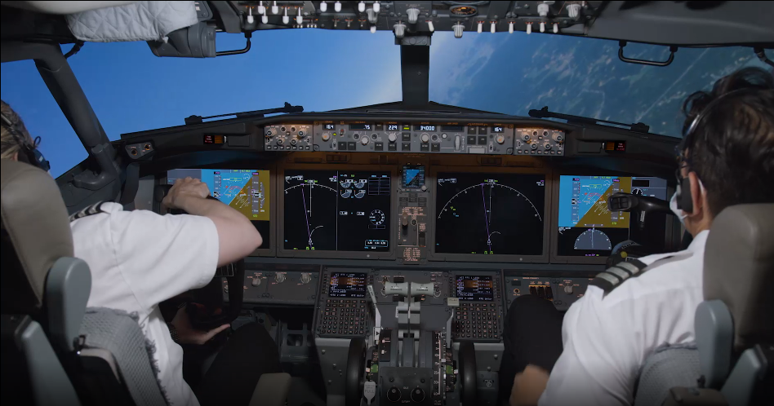
UPRT – Prevention or Recovery?
LOC-I and UPRT Workshop

Slide 3
Loss of Control-Inflight Countermeasures
LOC-I and UPRT Workshop
UA → URT → UPRT

Slide 4
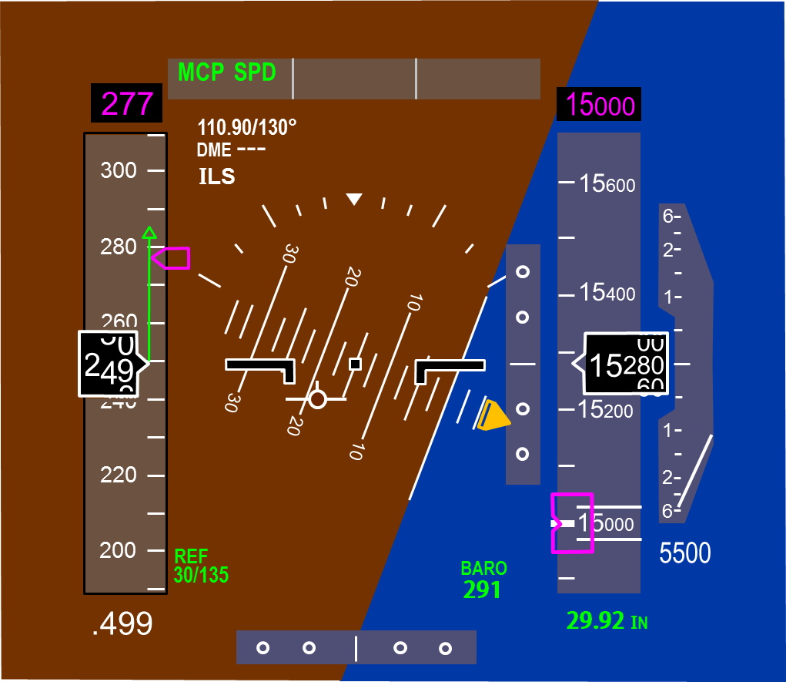
Unusual Attitude Definition
LOC-I and UPRT Workshop
Nose high pitch > 25 Degrees
Nose low pitch < -10 Degrees
Bank angle > 45 Degrees
Airspeed inappropriate for phase of flight
Or an Undesired Aircraft State

Slide 5
FAA Part 121 Requirements
LOC-I and UPRT Workshop
All part 121 air carriers, including those who train under an Advanced Qualification Program (AQP), are required to conduct UPRT beginning March 12, 2019. The requirement for part 121 pilots to receive upset training is statutorily mandated in Public Law 111-216, Section 208 and the FAA does not have the authority to exempt any part 121 air carrier from this requirement. Air carriers must include UPRT [and stall event training] for pilots during:
Initial training
Transition training
Differences and related aircraft differences training (if differences exist)
Upgrade training
Requalification training (if applicable) and
Recurrent training

Slide 6
FAA Part 121.423 Pilot: Extended Envelope Training
LOC-I and UPRT Workshop
Each certificate holder must include in its approved training program, the extended envelope training set forth in this section with respect to each airplane type for each pilot. The extended envelope training required by this section must be performed in a Level C or higher full flight simulator, approved by the Administrator in accordance with § 121.407 of this part.
Extended envelope training must include the following maneuvers and procedures:
(1) Manually controlled slow flight;
(2) Manually controlled loss of reliable airspeed;
(3) Manually controlled instrument departure and arrival;
(4) Upset recovery maneuvers; and
(5) Recovery from bounced landing.
Extended envelope training must include instructor-guided hands on experience of recovery from full stall and stick pusher activation, if equipped.

Slide 7
Our Goal – To Meet and Exceed all Global Standards
LOC-I and UPRT Workshop
FAA
14 CFR Part 121.423-Pilot: Extended Envelope Training
14 CFR Part 60 FTSD Evaluation and Qualification for Extended Envelope Training
AC 120-109A Stall Prevention and Recovery Training
AC 120-111 Upset Prevention and Recovery Training
AC 120-123 Flight Path Management
EASA
Opinion No 06/2017 Loss of Control and Recovery Training
EASA NPA 2017-13 Flight Simulation Training Device Requirements
CASA Consultation Draft: Guidance on Upset Prevention and Recovery Training
ICAO Document 10011: Manual on Aeroplane UPRT
IATA Loss of Control In-Flight (LOC-I) Prevention
ICATEE International Committee for Aviation Training in Extended Envelopes (Royal Aeronautical Society)
AUPRTA (Rev 2 & 3) Airplane Upset Prevention & Recovery Training Aid

Slide 8
AC 120-111 Upset Prevention and Recovery Training
LOC-I and UPRT Workshop
Enhanced instructor training on the limitations of simulation
Comprehensive pilot academic training on aerodynamics
Early recognition of divergence from intended flight path
Upset prevention through improvements in manual handling skills
Training that integrates Crew Resource Management (CRM) including progressive intervention strategies for the pilot monitoring

Slide 9
AC 120-109A Stall Prevention and Recovery Training
LOC-I and UPRT Workshop
Reducing Angle of Attack (AOA) is the most important pilot action in recovering from an impending or full stall.
Pilot training should emphasize teaching the same recovery technique for impending stalls and full stalls.
Evaluation criteria for a recovery from an impending stall should not include a predetermined value for altitude loss. Instead, criteria should consider the multitude of external and internal variables that affect the recovery altitude.
Once the stall recovery procedure is mastered by maneuver-based training, stall prevention training should include realistic scenarios that could be encountered in operational conditions, including impending stalls with the autopilot engaged at high altitudes.
Full stall training is an instructor-guided, hands-on experience of applying the stall recovery procedure and will allow the pilot to experience the associated flight dynamics from stall onset through the recovery. (e.g., increased buffet, reduced stability and control, and roll off)

Slide 10
AC 120-123 Flight Path Management
LOC-I and UPRT Workshop
Flight Path Management is the planning, execution, and assurance of the guidance and control of aircraft trajectory and energy, in flight or on the ground.
Ensuring that the aircraft is on a safe and correct flightpath is the highest priority of all pilots on the flightcrew.
Each pilot is responsible for:
• Being fully aware of the current and desired flightpath of the aircraft, and
• Being fully capable of manually flying the aircraft to achieve the desired flightpath.
The following chapters include guidance:
Chapter 3, Manual Flight Operations.
Chapter 4, Managing Automated Systems.
Chapter 5, Pilot Monitoring (§ 121.544) (including attention management).
Chapter 6, Energy Management.

Slide 11
Our Philosophy
LOC-I and UPRT Workshop
Design a UPRT/EET training program that meets or exceeds global standards.
Emphasize Crew Resource Management and Threat/Error Management skills.
Reinforce role of the Monitoring Pilot(s) and Flight Path Management.
Improve Manual Flying Skills and effective use of Automation.
Support simulator stall models with actual aircraft data.
Mitigate negative transfer risk with realistic scenarios and effective instruction.
Require rigorous instructor training and standardization.
Use portable tablet for UPRT/EET scenario activation and to provide student feedback.
Use data and instructor/customer feedback for continuous improvement.

Slide 12
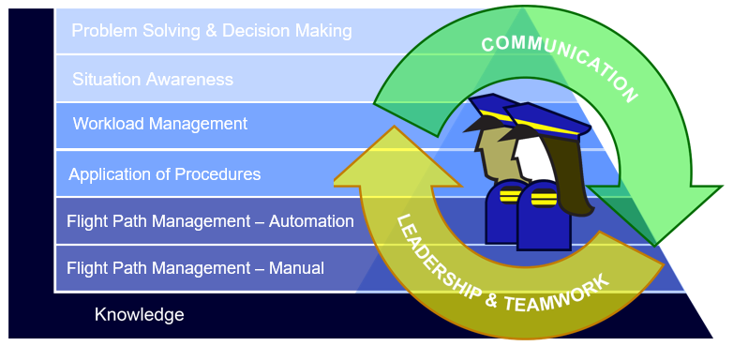
Competency Based Training-Assessment (CBTA)
LOC-I and UPRT Workshop

Slide 13
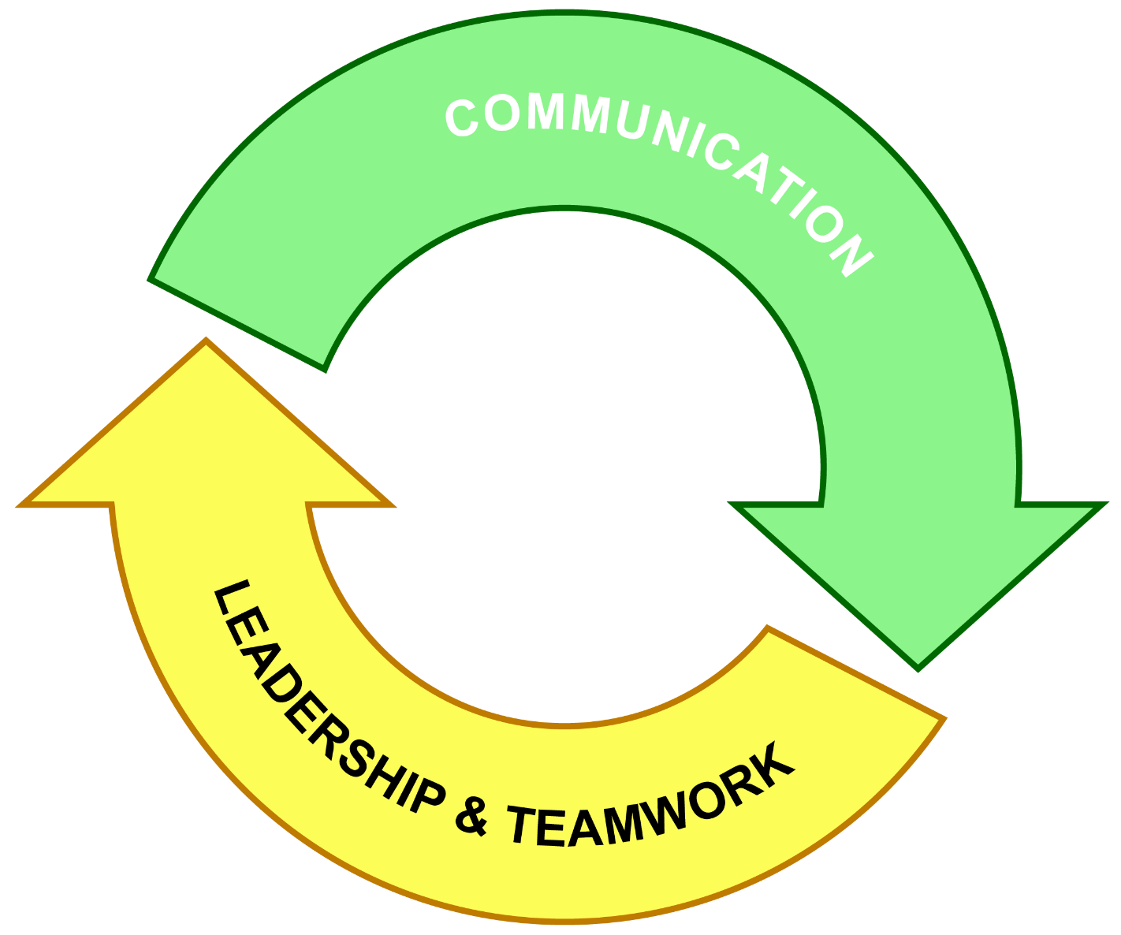
Building Block Approach
LOC-I and UPRT Workshop
Flight Path Management - Manual
Flight Path Management - Automation
Application of Procedures
Workload Management
Situation Awareness
Problem Solving &
Decision Making
Knowledge
CBTA Building-Block Progression

Slide 14
Mnemonic for Priorities
LOC-I and UPRT Workshop

Slide 15
FLY Focus ACT
LOC-I and UPRT Workshop

Slide 16
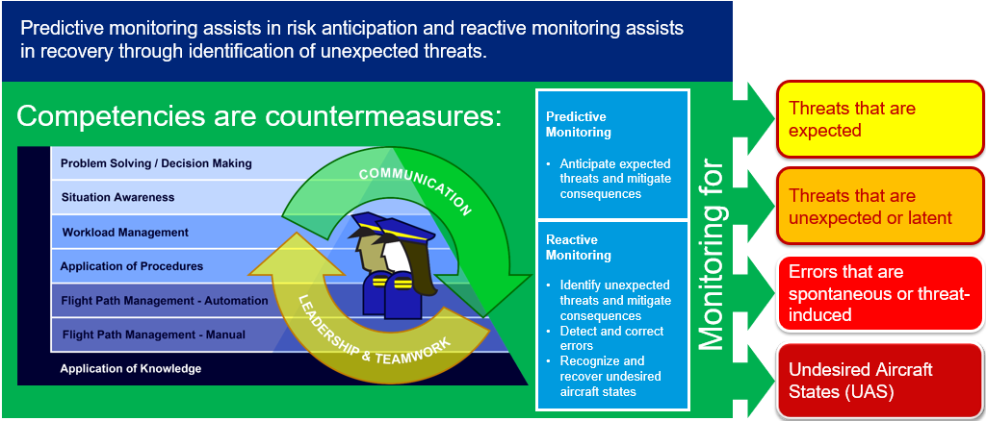
Threat and Error Management
LOC-I and UPRT Workshop

Slide 17
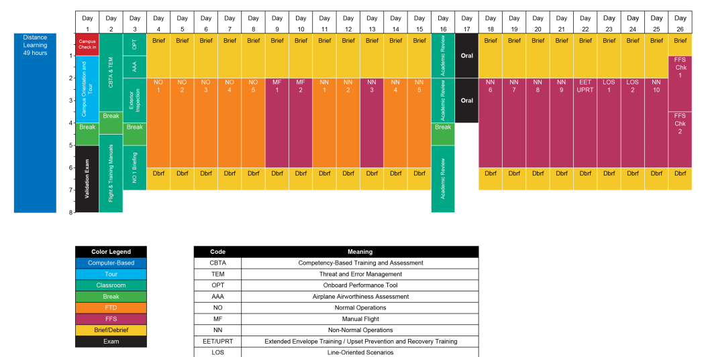
737 MAX FAA Type Rating Footprint (CBT-A)
LOC-I and UPRT Workshop

Slide 18
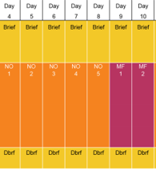
Flight Path Management - Manual
LOC-I and UPRT Workshop

Slide 19
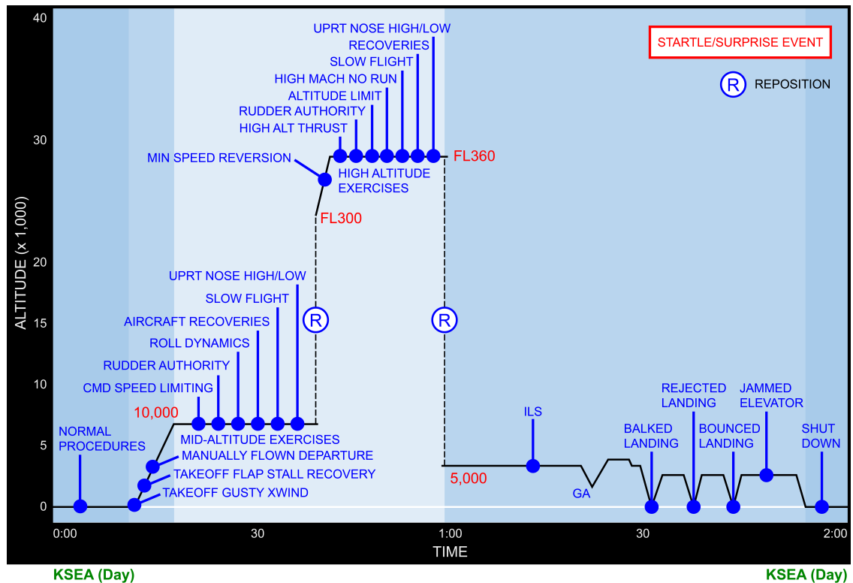
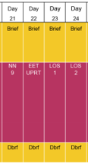
737 MAX Type Rating UPRT Lesson Profile
LOC-I and UPRT Workshop

Slide 20
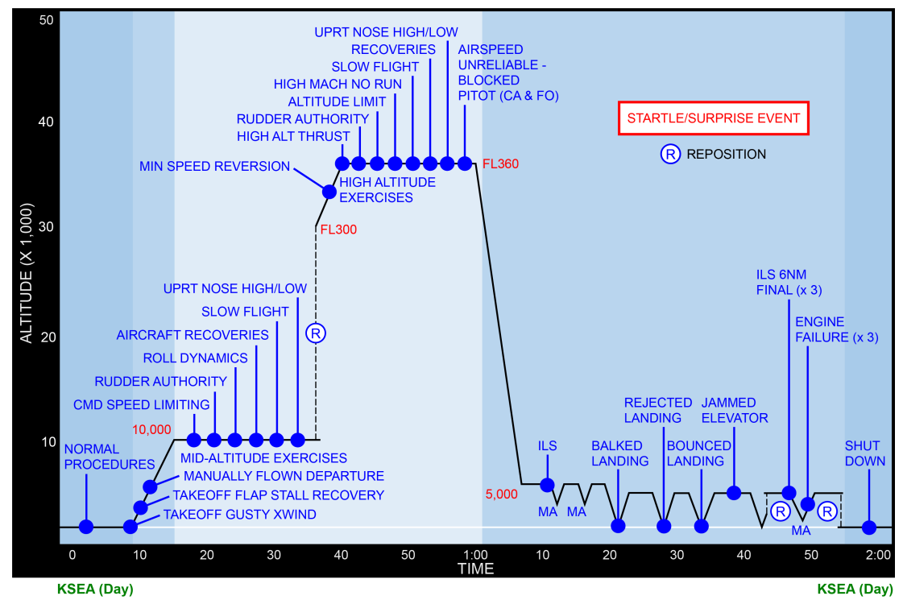
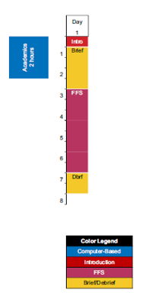
737NG/MAX UPRT Lesson Profile
LOC-I and UPRT Workshop
Notes:
● Ensure each maneuver is performed by each pilot, at least twice, at various bank angles. ● The ADI/PFD is the primary control instrument for recovery from an upset, as adequate outside visual references may not be available or may be misleading.
Review and clear the V-N and Alpha-Beta Plot Diagrams after each UPRT/EET and Stall Event.
● This demonstration will reinforce the concept that a proper approach to stall or stall recovery is done by reducing AOA. ● Approach to stall recovery will require the angle of attack/pitch to be reduced, perhaps significantly, in order to recover from the stall.
Point out that buffet onset may occur before stick shaker at high altitudes.

Slide 21
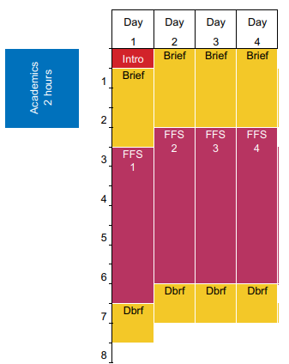
Boeing UPRT Instructor Training Course
LOC-I and UPRT Workshop

Slide 22
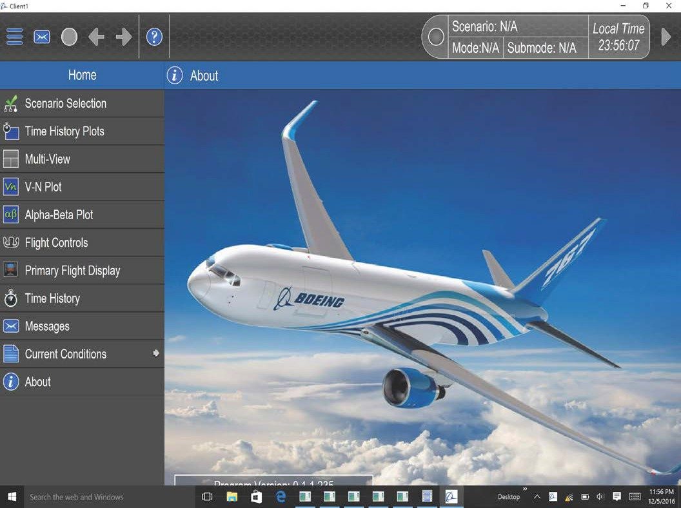
Boeing Instructor Tool
LOC-I and UPRT Workshop

Slide 23
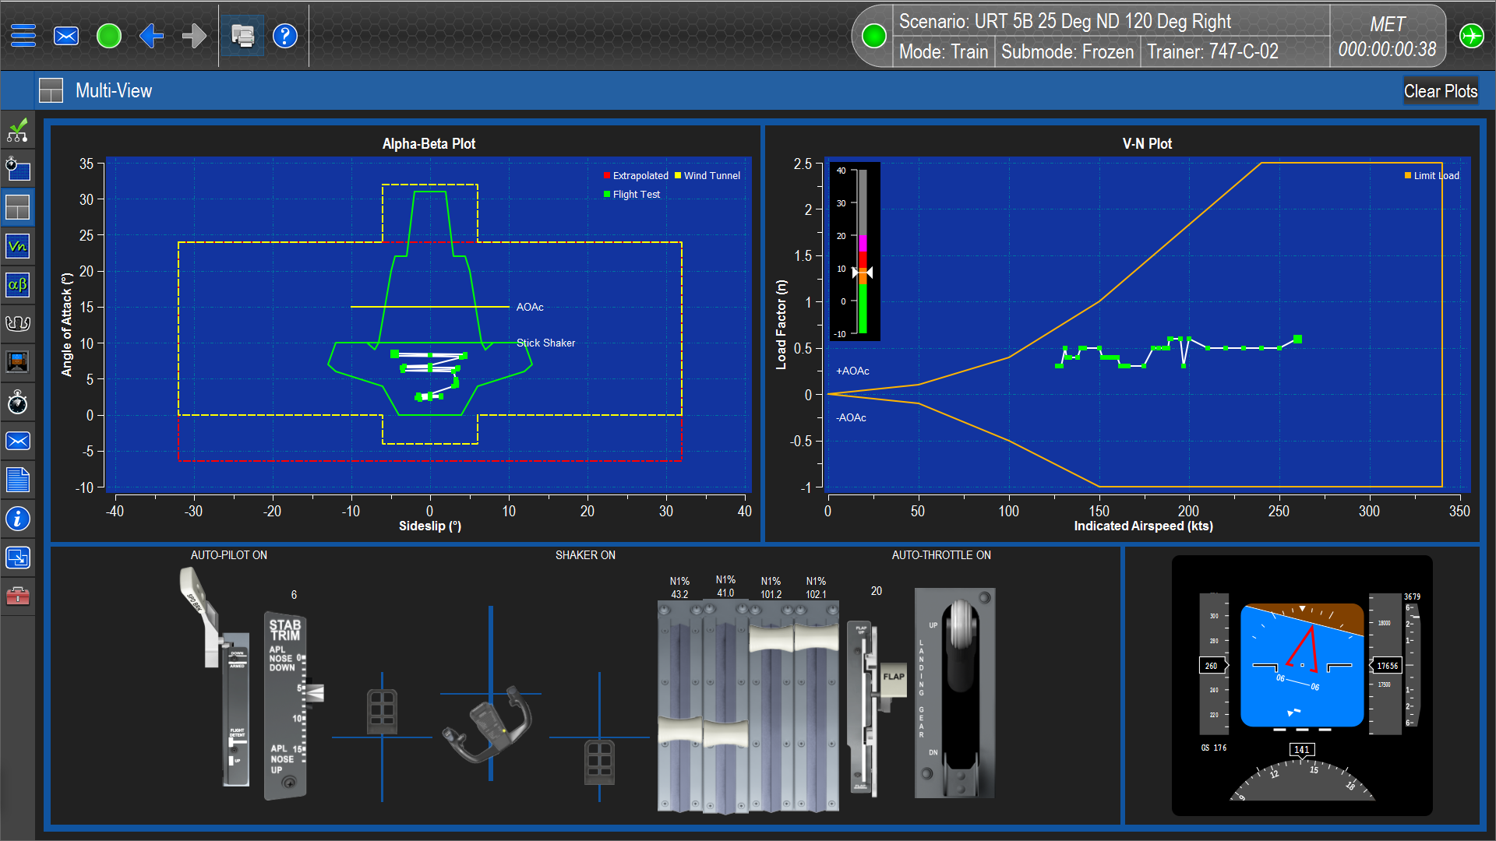
Instructor Operator Station Improvements
LOC-I and UPRT Workshop
Regulations require an instructor feedback mechanism
FSTD validation envelope
Flight control inputs
Aircraft operational limits
Boeing has developed a tablet based solution
Cost effective (especially for older devices)
Provides instructors with an efficient and effective tool for feedback

Slide 24
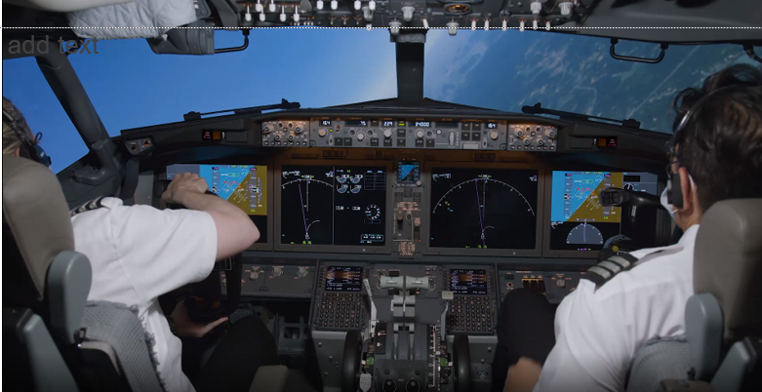
“UPRT – The Movie” is available on My Boeing Fleet
LOC-I and UPRT Workshop

Slide 25
Summary
LOC-I and UPRT Workshop
UPRT creates awareness
Stalls and upsets do occur
Enhances flight training
Manual Flight Control Skills
Automation management
Pilot Monitoring Skills
Prevention and Recognition
Flight Path Management
Crew Resource Management
Threat and Error Management
Maneuver/Scenario Based Training
Increases crew competence
Improves confidence
Develops resilience

Slide 26
LOC-I and UPRT Workshop
Non-qualified simulators
Mitigation Strategies
Boeing doesn’t recommend training in non-qualified simulators.
Need specific make and model. Control forces and responses vary..
Using other pilot to set up unusual attitude.
Should have preset upsets for standardization.
Training beyond validated training envelope.
IP in seat. Limits PM to observe or demonstrate and let student be PM.
Lack scenario based training. Realistic dynamic scenarios required.
Limit training to maneuver training.
Use instructor in seat to set up standardized delivery.
Limit stalls to stick shaker and brief alerts warnings and flight deck effects.
Robust theory and aero review.
Specifically qualified instructors.

Slide 27
Questions?
Thank You

